Slide 2
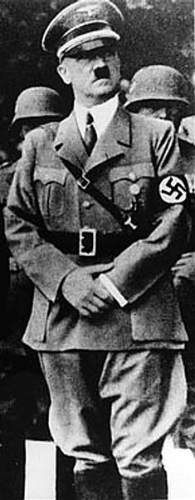
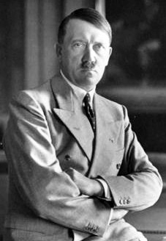
Born in Austria in 1899
Moved to Munich, Germany, later in life
Dictator of Germany from 1933-1945
Leader of the National Socialist German Worker’s Party, also known as the Nazi Party
How did Hitler turn a democratic Germany into an autocratic state?
Before Hitler became involved in politics, he was a soldier fighting for Germany in World War I (1914-1918).
Hitler became a strong German patriot and fell in love with war.
When WWI ended, Hitler was very upset Germany had lost the war.
Notes:
**Click on the video. The video is a link to History Channel at http://www.history.com/topics/world-war-ii/adolf-hitler/videos/adolf-hitler-fast-facts?m=528e394da93ae&s=undefined&f=1&free=false
The video is a 5 minute clip that includes facts about Adolf Hitler.

Slide 3
Signed in June 28, 1919, to formally end WWI
Negotiated by the leaders of the Allies with little German representation
The treaty held severe consequences for Germany.
Many Germans were unhappy with the Treaty of Versailles, including Hitler.
Why were so many Germans upset with the Treaty?
Germany had to accept full blame for starting WWI.
Germany had to pay reparations to countries devastated by the war.
Germany lost land and all of its worldwide colonies.
Germany had to reduce the size of its military and weapons.
Many people agree that this treaty was a contributing factor of Hitler gaining power in Germany and World War II beginning.
Notes:
**Click on the video. The video is a link to Kahn Academy at https://www.khanacademy.org/humanities/world-history/euro-hist/ww1-aftermath/v/more-detail-on-the-treaty-of-versailles-and-germany
The video is about the Treaty of Versailles and Germany. It is about 6 minutes.

Slide 4
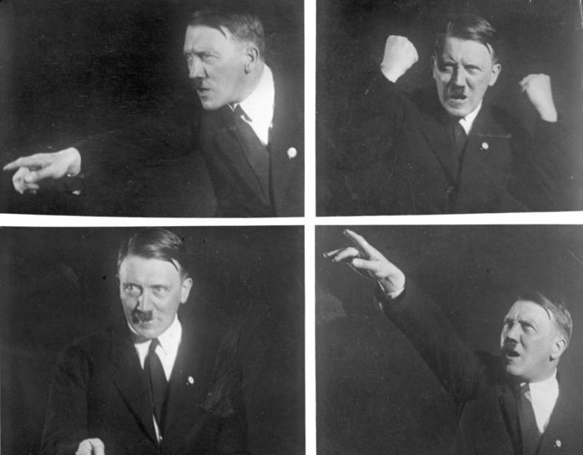
After WWI, Germany fell into a deep depression.
Germany had to pay reparations to other countries but did not have enough money to do so.
Germany also did not have enough money to rebuild itself from the damage of WWI.
Hitler was very angry with the situation in Germany.
So he entered politics.
Hitler gave many powerful speeches that Germans believed.
Hitler became the leader of the National Socialist German Worker’s Party, also known as the Nazi Party.
Hitler gathered enough support to lead a coup against Germany’s government, the Weimar Republic, in 1923.
Notes:
**Click on the photo. The photo is a link to History Channel at http://www.history.com/speeches/adolf-hitler-on-the-sudetenland-crisis
The link is a sound audio of Hitler’s speech given in 1938 where Hitler talks about how Germans living in Czechoslovakia want closer ties with Germany, meaning that Hitler wants to take over this region of Czechoslovakia. The sound link is in German, but it also includes the crowd’s cheering so students can hear how Hitler was able to ignite passion in the German people.
**Click on the video. The video is a link to Kahn Academy at https://www.khanacademy.org/humanities/world-history/euro-hist/hitler-nazis/v/initial-rise-of-hitler-and-the-nazis
The video is about 11 minutes and about the initial rise of Hitler and the Nazi Party.

Slide 5
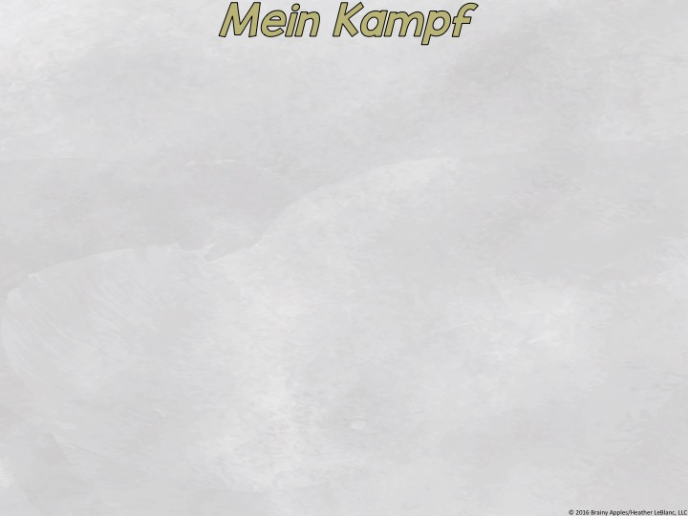
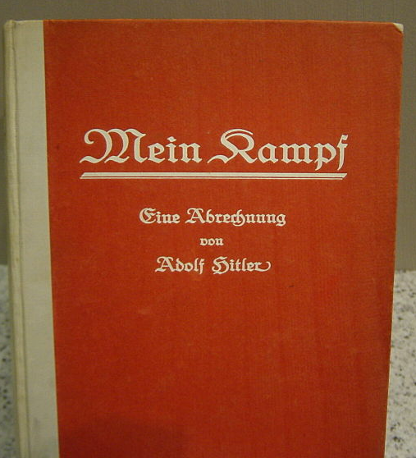
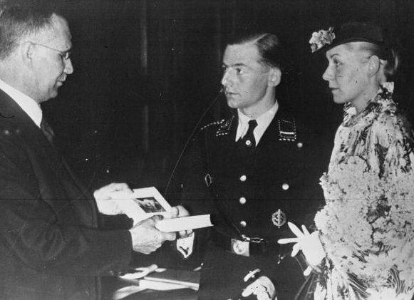
Hitler’s coup failed, and he was sentenced to 9 months in prison.
While in prison, Hitler wrote Mein Kampf.
Mein Kampf
autobiography
detailed his plan of how to solve Germany’s problems
Hitler’s Solutions
Hitler gave every couple a copy of his Mein Kampf on their wedding day.
expand German lands
elimination of “impure” races
creating a German dictatorship
When Hitler was released from prison, he continued to give fiery speeches that ignited the German people.
Notes:
**Click on the photo of the Mein Kampf. The photo is a link to Kahn Academy at https://www.khanacademy.org/humanities/world-history/euro-hist/hitler-nazis/v/hitler-s-beer-hall-putsch
The video is about the coup that Hitler staged at the Beer Hall Putsch and his autobiography Mein Kampf.

Slide 6
In 1929, the US Stock Market crashed.
This event worsened the German economic depression.
Hitler and his Nazi Party took advantage of the situation.
Why?
Germany’s economy was being supported by loans from US banks because Germany did not have enough money to pay the reparations.
When the market crashed, the US banks wanted Germany to pay their loans back immediately.
Obviously Germany could not do this.
German businesses failed.
Germans lost their jobs.
Germans wanted solutions.
Notes:
**Click on the video. It is a link to Kahn Academy at https://www.khanacademy.org/humanities/world-history/euro-hist/hitler-nazis/v/hitler-and-the-nazis-come-to-power
The video talks about the US Stock Market Crash. Watch from the beginning to the 2:02 mark.

Slide 7
Germany’s democratic governmental system was called the Weimar Republic.
Hitler lashed out against the Weimar Republic, and many Germans began to support Hitler.
Hitler made many promises to the German people.
Economy
offered solutions for Germany’s economic problems
Strength
promised to make Germany a powerful country in Europe and the world
Blame
united the German people against the Jews by blaming the Jews for Germany’s problems
Protection
increased Germany’s military and weapon production, promising the German people he could protect them
Nationalism
called for an increase in Germany’s lands
Terror
After becoming dictator, Hitler banned all other political parties and sent those who spoke against him to concentration camps.

Slide 8
Hitler is now dictator.
1932
Nazi Party wins the majority of the vote (37%) in the Reichstag, the German Parliament.
1933
Hitler is appointed Chancellor of Germany.
Hitler begins to turn Germany into a fascist state.
Hitler begins to pass laws to change Germany’s constitution.
Why is this allowed?!
The Reichstag building is set on fire, and Hitler blames the communists.
An emergency decree is put in place that suspends civil liberties.
Many now think Hitler was behind the fire, so he could convince the German government to put the emergency decree in place.
With the emergency decree, Hitler is able to gain sole control of the legislature.
Notes:
**Click on the video. The video is a link to Kahn Academy at https://www.khanacademy.org/humanities/world-history/euro-hist/hitler-nazis/v/hitler-and-the-nazis-come-to-power
The video is about Hitler and the Nazi Party gaining power in Germany. Begin at the 2:03 mark to the end.

Slide 9
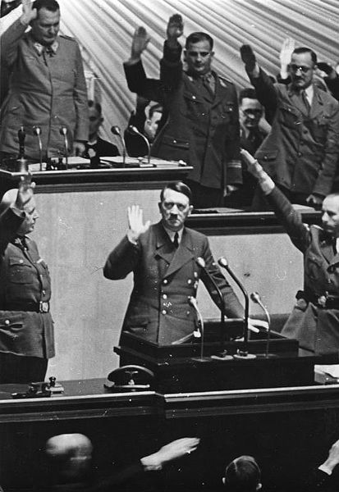
With Hitler dictator of Germany, he has total control.
A fascist state is a country that has as strong central government controlled by the military and led by a dictator.
Hitler bans all other political parties.
Anyone who spoke out against Hitler or his Nazi Party were terrorized by private, armed groups.
Opponents were sent to concentration camps.
The first concentration camp was in Dachau, Germany, and it housed political opponents.
Opponents were not just other political parties. Even opponents within the Nazi Party were terrorized and sent to camps.
Hitler soon faced no opposition.
Notes:
**Click on the video. The video is a link to Kahn Academy at https://www.khanacademy.org/humanities/world-history/euro-hist/hitler-nazis/v/night-of-the-long-knives
The video is about how Hitler removed ALL political opponents, not just other parties but also opponents within the Nazi Party.

Slide 10
With Hitler dictator of Germany and no opposition, he begins to expand the German Empire.
Hitler began to violate the Treaty of Versailles.
rebuilds military and increases weapons
stops paying reparations
expands German lands
Appeasement
Great Britain and France were aware of Hitler’s actions but look the other way to avoid another conflict.
Hitler became more aggressive and annexed Austria and took over part of Czechoslovakia in 1938.
They hoped that Hitler would become satisfied with gaining some land and stop.
Hitler saw that Great Britain and France were not going to stop him, so he invaded Poland on September 1, 1939, which started World War II.
Notes:
**Click on the video. The video is a link to Kahn Academy at https://www.khanacademy.org/humanities/world-history/euro-hist/hitler-nazis/v/nazi-aggression-and-appeasement
The video is about Hitler’s growing aggression, and Great Britain and France’s appeasement. It is about 7 minutes long.

Slide 11
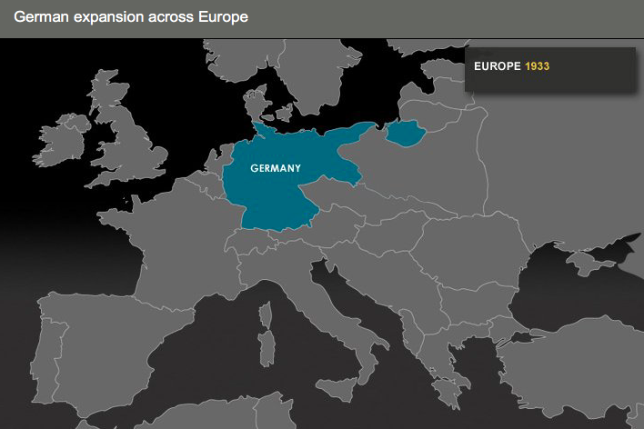
Once Hitler invaded Poland, the German army quickly took over most of Europe using a lightening war called a Blitzkrieg.
By the end of 1940, most of Europe was under Hitler’s control.
Hitler not only wanted to conquer all of Europe, he wanted to rid Europe of “impure” races.
He blamed the Jews for Germanys problems.
He also targeted other groups of people he considered inferior for the New Germany.
Romas
Slavs
Jehovah’s Witnesses
mentally disabled
physically disabled
and more…
Notes:
**Click on the map. The mapis a link to http://www.theholocaustexplained.org/ks3/the-final-solution/german-expansionism/german-occupation-of-europe/#.Vwz_yYTU_DI
The map shows a progression of Nazi-occupied lands. Click on the thumbnails below the map to see the progression.

Slide 12
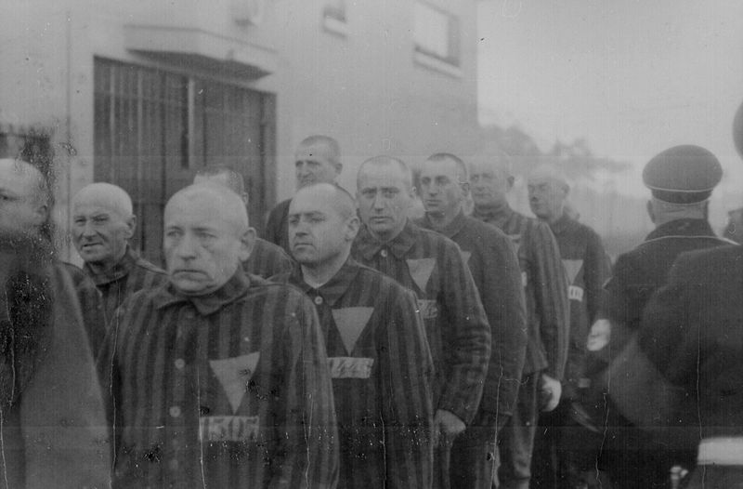
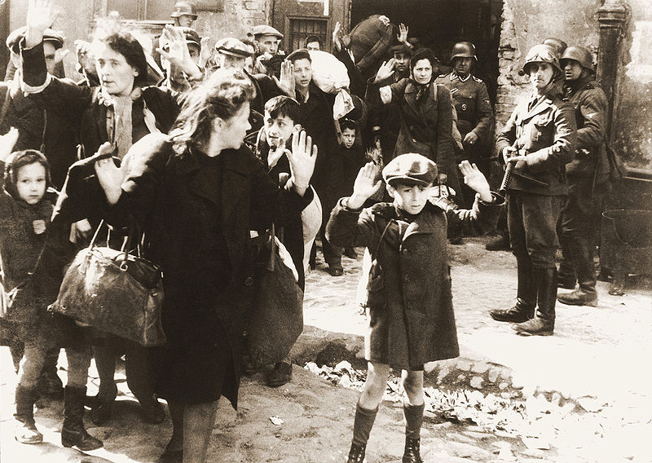
1933-1945
Began when Hitler and the Nazis came to power in Germany
At first, Jewish businesses are boycotted (1933), and then
laws were passed that discriminated against Jews (1935: Nuremberg Laws).
Hitler’s hatred of certain races, ethic groups, and peoples resulted in the genocide of 11 million men, women, and children.
The Holocaust was a systematic state-sponsored persecution and murder of innocent peoples.
Millions were sent to concentration camps and death camps.

Slide 13
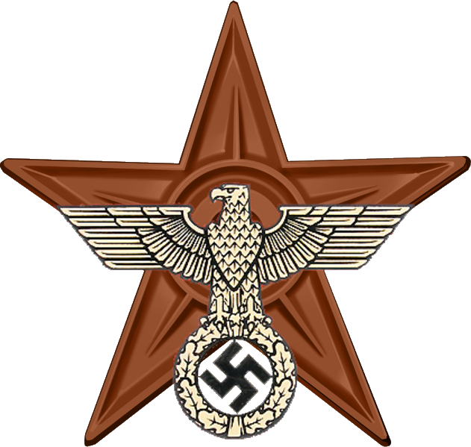
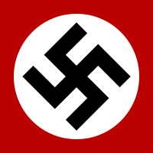
Hitler remained aggressive, attacking European countries not yet under his control.
Finally, in 1945, the US and Soviet Union armies closed in on Hitler.
In January, 1945, Hitler retreated to his underground bunker in Berlin, Germany.
When Hitler realized that defeat was imminent, he committed suicide on April 30, 1945.
Hitler and his Nazi Party’s reign of terror was finally over.
After WWII ended, all symbols associated with Hitler and the Nazi Party were outlawed in an effort to purge their influence from German life.

