Slide 1
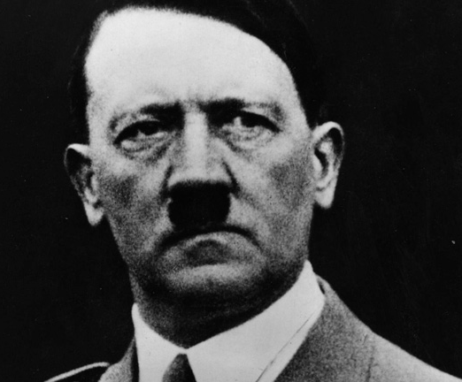
Occurred in Europe
1933-1945
Holocaust is a word of Greek origin = sacrifice by fire
→systematic, state-sponsored persecution and murder of 11 million people by the Nazis and its collaborators
systematic = planned
state-sponsored = planned and ordered by the government
persecution = to treat cruelly
collaborator = to work with someone to achieve something
The Holocaust began when Adolf Hitler and his Nazi Party came to power in Germany in January 1933.
The Holocaust continued until Germany fully surrendered to the Allies on May 7, 1945.
Notes:
**Click on the photo of “1933”. The photo is a link to a video at https://www.youtube.com/watch?v=5tGKfIJwrh4
The video is Hitler’s first speech after being appointed Chancellor of Germany. It is about 3 minutes long. It has English subtitles.

Slide 2
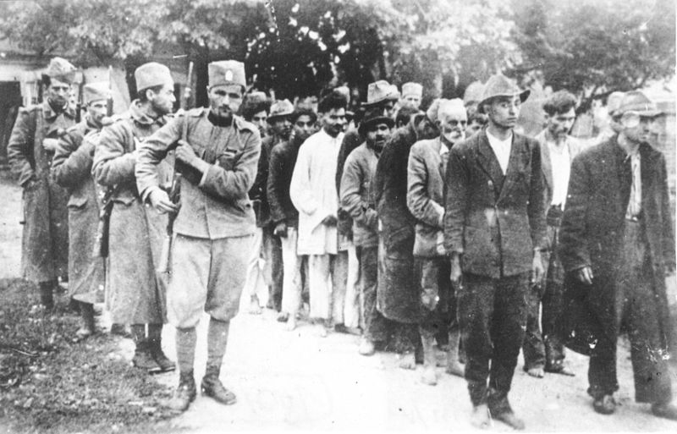
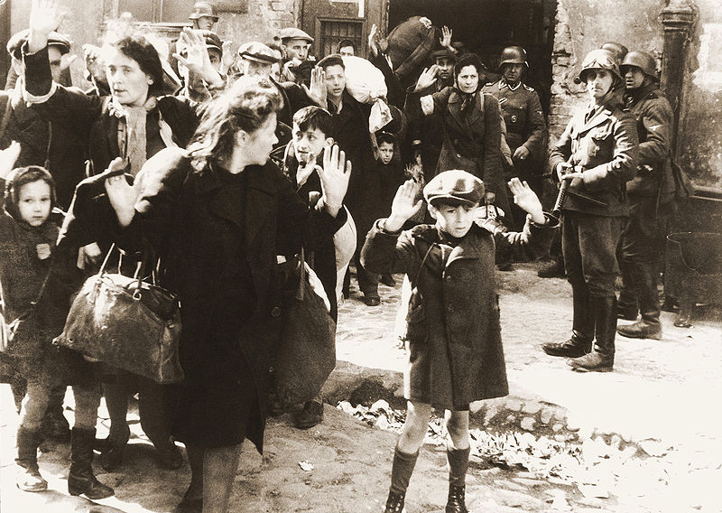
Those persecuted by Hitler and his Nazi Party
Hitler wanted a pure German race = Aryan Race
He wanted to rid Germany and then Europe of any threats to his superior race.
Roma
Slavs
Jehovah Witnesses
Hitler’s political opponents
mentally & physically disabled
even members of Hitler’s own Nazi Party
and others...

Slide 3
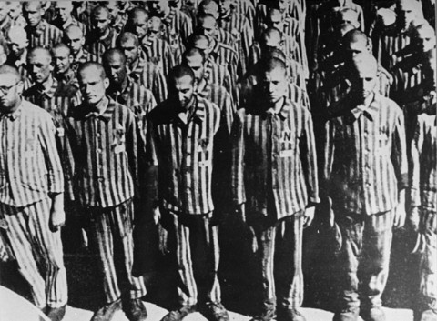
The Jews were the primary targets of Nazi racism = 6 million killed
In 1933, over 9 million Jews were living in Europe.
In 1945, there were only 3 million.
Notes:
*Copy the following link in your browser: https://www.ushmm.org/wlc/en/media_nm.php?ModuleId=10005143&MediaId=358
The map shows the Jewish population in Europe around 1933, before the Holocaust.
*Copy the following link in your browser: https://www.ushmm.org/wlc/en/media_nm.php?ModuleId=10005143&MediaId=360
The map shows the Jewish population in Europe around 1950, after the Holocaust.
*Copy the following link in your browser: https://www.ushmm.org/wlc/en/media_nm.php?MediaId=3372
It shows a progression of the Holocaust. It is about 2 minutes long.
*Click on the bottom left photo. The photo is a link to a video at https://www.youtube.com/watch?v=_0V_xf3OQgM
The video is a speech by Hitler about the Jews. It is a little over 1 minute long. It has English subtitles.
*Click on the bottom right photo. The photo is a link to a video at https://www.youtube.com/watch?v=XMjGt8snhFU
The video is a speech by Hitler about the Jews and the Allies. It is a little over 3 minutes long. It has English subtitles.

Slide 4
Mein Kampf = autobiography by Hitler written in 1923 while he was in prison for leading a failed coup
In this book he predicted a war in Europe that would end with the extermination of the Jewish race in Europe.
Hitler viewed the Jews as a race and not a religious affiliation.
Anti-Semitism
Why Didn’t Jews Leave?
hostility or prejudice towards Jews
Germany was their home.
They were patriotic citizens.
present before Hitler took power
Their rights were taken away in stages from 1933-1939.
Hitler and his Nazi Party used propaganda to help it quickly spread.
Many Jews believed there would be a change in German politics.
German government gradually passed discriminatory laws targeting Jews from 1933-1939.
Few could have predicted mobile killing units and extermination camps.

Slide 5
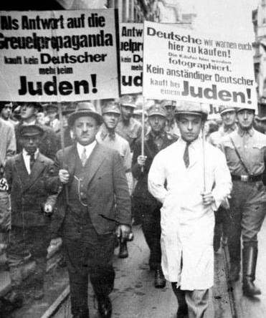
Jews lost their positions in government and Jewish businesses were closed.
Books written by Jews (and others Hitler deemed as “dangerous”) were burned in a public ceremony.
A Jewish shop is boycotted. The sign says, “Germans, defend yourselves! Don’t buy from Jews!”
Jews became targets of persecution.
Sept. 1935: Nuremberg Laws
encouraged more discrimination against Jews
stated that only Aryans could be full German citizens
German businesses refused service to Jews, including hospitals.
Jewish children were no longer allowed to attend school.
became illegal for an Aryan to marry a Jew
Viewed Jews as a race and not a religious group
3 or 4 Jewish Grandparents = Jew
Jews forced to march with signs that say, “Don’t buy from Jews” and “A good German doesn’t buy from Jews.” The men in uniform are Nazis.
Even if the person was Catholic!
1 or 2 Jewish Grandparents = Half-Breed or Mischlinge

Slide 6
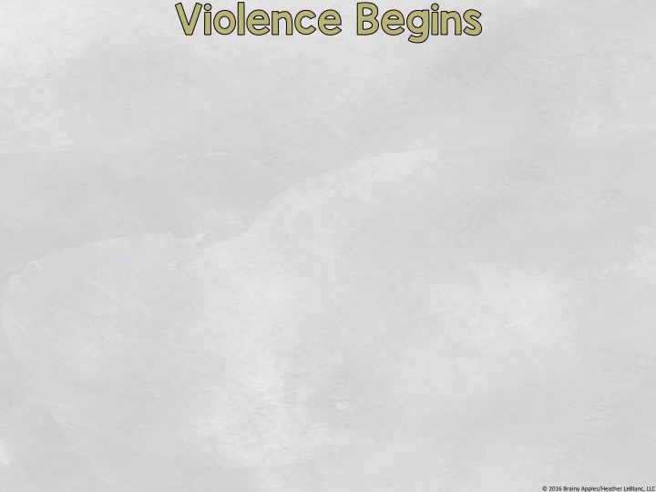
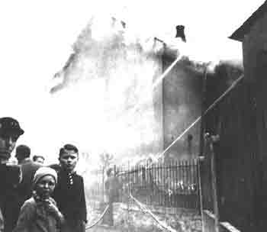
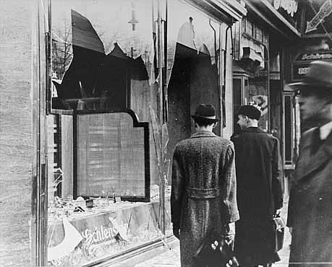
Most of the discrimination against the Jews had been nonviolent.
This changed on November 9, 1938.
Kristallnacht
Nov. 9-10, 1938
“Night of the Broken Glass”
Widespread violence against the Jews
Jewish synagogues, businesses, homes, hospitals, and schools were vandalized, if not completely destroyed.
A Jewish synagogue burns. The water is being sprayed on Aryan-owned homes so they don’t burn, too.
Jewish shops that weren’t burned completely have broken windows.
The Nazis ordered German policeman and firefighters to do nothing as Jews were beaten and buildings burned.
The firemen were allowed to extinguish a blaze that threatened a Aryan-owned property, though.

Slide 7
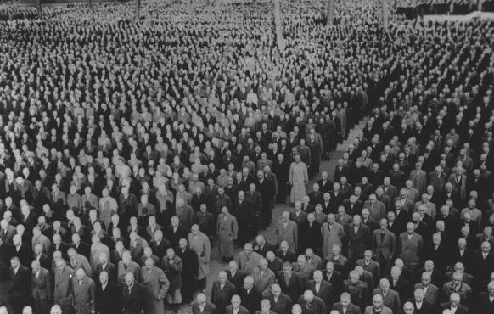
Jews now faced increasing violence.
Roll call of Jews after Kristallnacht.
100 Jews were killed, and 30,000 were arrested and sent to concentration camps.
This was the first time Jews had been sent to concentration camps. Up to now, Hitler sent his political opponents to concentration camps.
The first concentration camp opened in March, 1933, in Dachau, Germany.
Hitler and the Nazis blamed the Jews for the damage and fined the Jewish community $400 million.

Slide 8
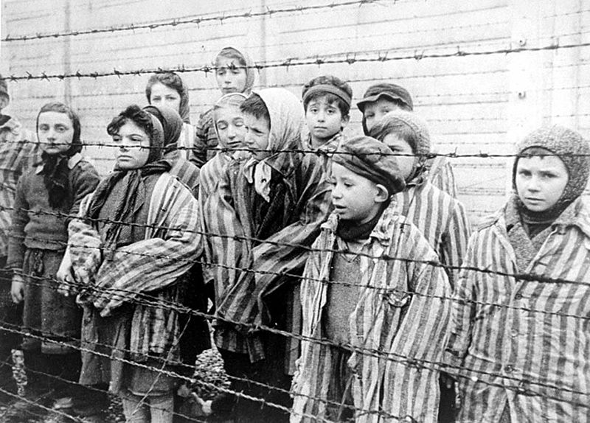
initially created to house Hitler’s political opponents
Inmates were forced to work hard labor with little food.
They also faced daily beatings and diseases were common.
Those too weak to work were killed.
Concentration camps were established all over Europe.
Men, women, and children were sent to the camps.
Notes:
*Copy the following link in your browser: https://www.ushmm.org/wlc/en/media_nm.php?MediaId=7825
The animated map discusses the Dachau concentration camp. It is about 4 minutes long.
******THE VIDEO USES THE WORD “HOMOSEXUAL” ONCE, AS WELL AS PHOTOS OF DEAD BODIES, SO BE SURE THIS IS APPROPRIATE FOR YOUR STUDENTS.******
*Copy the following link in your browser: https://www.ushmm.org/wlc/en/media_nm.php?MediaId=354
It shows a map of the camps across Europe in 1944.

Slide 9
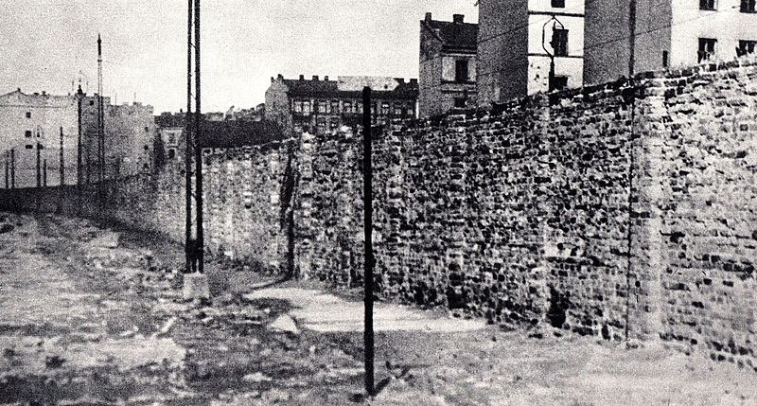
Sept. 1939: The German army invaded and occupied western Poland.
Ghettoes
Polish Jews are forced from their homes into ghettoes.
surrounded by either high walls and/or barbed wire
Jews were not allowed to leave, as they were heavily guarded.
overcrowded
no medical care
many died
some were sent to concentration camps
disease spread quickly
many were starving
Notes:
*Copy the following link in your browser: https://www.ushmm.org/wlc/en/media_nm.php?MediaId=356
The maps shows the major ghettoes in occupied Europe ghettoes from 1939-1944.
*Copy the following link in your browser: https://www.ushmm.org/wlc/en/media_nm.php?MediaId=3373
This video talks about the Lodz ghetto. The video is 4 minutes long.
*Copy the following link in your browser: https://www.ushmm.org/wlc/en/media_nm.php?MediaId=3375
This video talks about the Warsaw ghetto. The video is 2 ½ minutes long.
*Copy the following link in your browser: https://www.ushmm.org/wlc/en/media_fi.php?ModuleId=10005143&MediaId=189
This video gives a brief inside look at the Lodz ghetto. The video is about 1 ½ minutes long.
*Copy the following link in your browser: https://www.ushmm.org/wlc/en/media_fi.php?MediaId=252
This video gives a brief inside look at the Warsaw ghetto. The video is about 1 minute long.
*Copy the following link in your browser: https://www.ushmm.org/wlc/en/media_fi.php?ModuleId=10005143&MediaId=253
This video gives a brief inside look at the Warsaw ghetto. The video is about 1 ½ minutes long.
*Copy the following link in your browser: https://www.ushmm.org/wlc/en/media_fi.php?MediaId=251
This video gives a brief inside look at the Warsaw ghetto. The video is a little over 1 minute long.
*Copy the following link in your browser: https://www.ushmm.org/wlc/en/media_fi.php?ModuleId=10005143&MediaId=188
This video gives a brief look at Jews moving into the Krakow ghetto. The video is about 1 ½ minutes long.

Slide 10
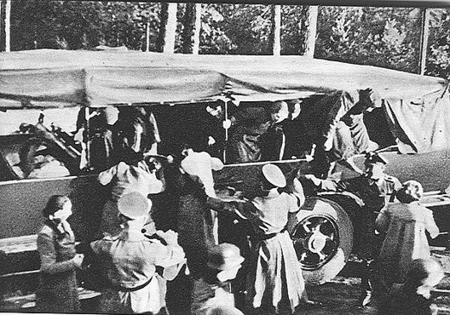
Jews who lived in countries conquered by Germany were sent to the ghettoes.
Introduction of Mobile Killing Units
began when Germany invaded the Soviet Union in 1941
set up across eastern Europe
mass-murder of Jews, Roma, Slavs, prisoners of war, political opponents, and others
usually mass firing squads or gas vans
over a million were killed
Notes:
*Copy the following link in your browser: https://www.ushmm.org/wlc/en/media_nm.php?MediaId=342
The map show the locations of the mobile killing units.
*Copy the following link in your browser: https://www.ushmm.org/wlc/en/media_nm.php?MediaId=8862
The link is an animated map that shows and discusses the mobile killing units.
*********THE LINK SHOWS PHOTOS THAT DEPICT JEWS BEING SHOT. EXERCISE CAUTION WITH SHOWING YOUR STUDENTS. PLEASE DETERMINE IF THE CONTENT IS APPROPRIATE FOR YOUR STUDENTS. *********
*Copy the following link in your browser: https://www.ushmm.org/exhibition/personal-history/media_oi.php?MediaId=2951&th=rescue
Fima L. talks about being saved during a mobile killing unit. The video is about 3 ½ minutes long.

Slide 11
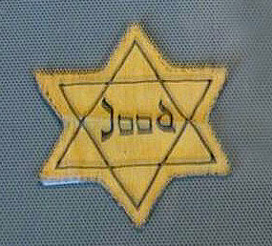
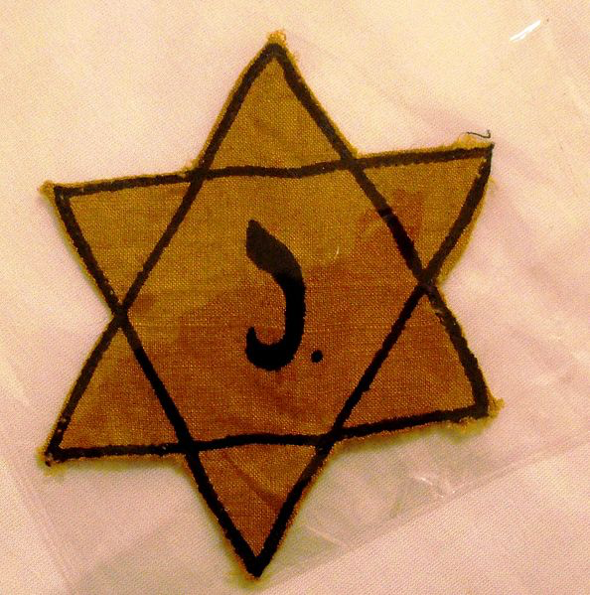
Hitler’s plan began to be implemented mid-1941.
Total extermination of the Jews from Europe.
All Jews in German-occupied lands were forced to wear the Star of David, a symbol of Judaism.
Hundreds of thousands of Jews were sent to the ghettoes.
Beginning in late 1941, the ghettoes began to be liquidated.
Millions of Jews were deported from the ghettoes in Nazi-controlled countries and its Axis allies’ countries to extermination camps.
Notes:
*Copy the following link in your browser: https://www.ushmm.org/wlc/en/media_nm.php?MediaId=362
The link is a map that shows the major deportations to the extermination camps.

Slide 12
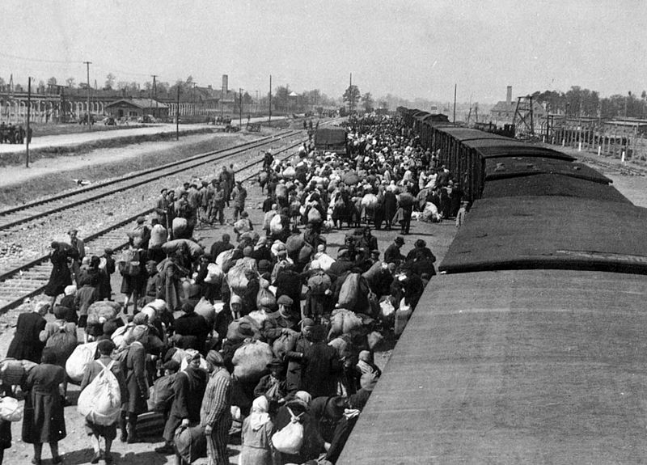
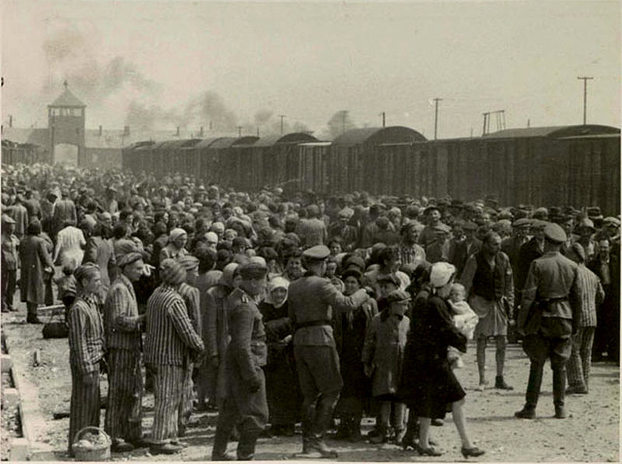
Jews were brought to extermination camps by railroads, traveling in overcrowded cattle cars.
Extermination camps had killing facilities, mostly gas chambers, that could kill thousands of people at one time.
The deadly gas Zyklon-B was used.
Auschwitz-Birkenau
largest extermination camp
over 2 million people died here
As many as 12,000 Jews a day were murdered during the summer of 1944.
Jews arrive at Auschwitz-Birkenau.
The first people sent were the sick, old, and weak, and the very young because the Nazis viewed them as the least useful.
Selection at Auschwitz-Birkenau. Jews were either sent to work or to the gas chambers.
Notes:
*Copy the following link in your browser: https://www.ushmm.org/wlc/en/media_nm.php?MediaId=427
The map shows the extermination camps during the Holocaust.
*Copy the following link in your browser: https://www.ushmm.org/wlc/en/media_nm.php?MediaId=3371
The animated map is about Auschwitz-Birkenau. It is a little over 2 minutes long.
*Copy the following link in your browser: https://www.ushmm.org/exhibition/personal-history/media_oi.php?MediaId=2932&th=survival
Ruth Meyerowitz talks about surviving a selection. The video is about 2 minutes long.

Slide 13
When Germany began to lose WWII in the summer of 1944, they wanted to hide all evidence of the mass killings.
Inmates of the camps were forced on death marches.
The Nazis wanted them away from the advancing Allied forces.
Over 300,000 died on these marches.
Many collapsed from exhaustion and were shot.
Others died form starvation and exposure to the winter temperatures.
Death marches continued until May 1, 1945.
Notes:
*Copy the following link in your browser: https://www.ushmm.org/exhibition/personal-history/media_oi.php?MediaId=1172&th=survival
Lily Mazur Margules talks about her experience on a death march. The video is about 1 minute long.
*Copy the following link in your browser: https://www.ushmm.org/exhibition/personal-history/media_oi.php?MediaId=1171&th=camps
Lilly Appelbaum Malnik talks about her experience on a death march. The video is about 2 minutes long.
*Copy the following link in your browser: https://www.ushmm.org/exhibition/personal-history/media_oi.php?MediaId=2863&th=camps
Fritzie Weiss Fritzshall talks about her experience on a death march. The video is about 1 ½ minutes long.
*Copy the following link in your browser: https://www.ushmm.org/exhibition/personal-history/media_oi.php?MediaId=2892&th=camps
Steven Springfield talks about his experience on a death march. The video is about 2 minutes long.

Slide 14
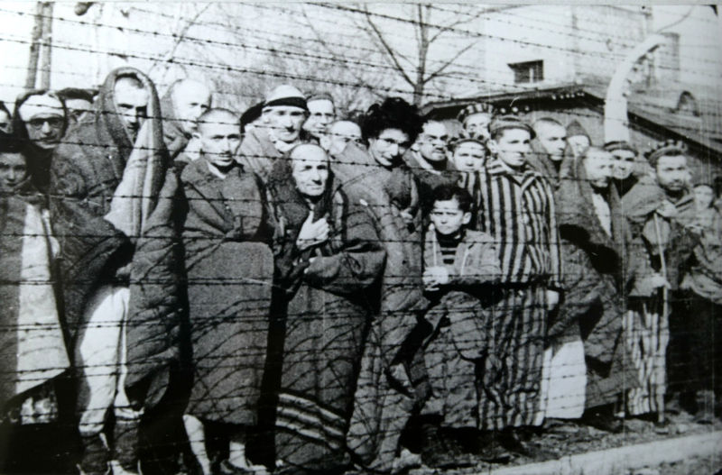
The Nazis tried to destroy as much of the camps as they could as the Allies advanced, but many gas chambers were left standing.
Any survivors at the camps were freed by the Allied forces.
Notes:
*****THE VIDEO SHOWS DEAD BODIES, SO MAKE SURE THE CONTENT IS APPROPRIATE FOR YOUR STUDENS.*****
*Copy the following link in your browser: https://www.ushmm.org/wlc/en/media_nm.php?MediaId=7826
The video talks about liberation of the camps. The video is about 3 minutes long.

Slide 15
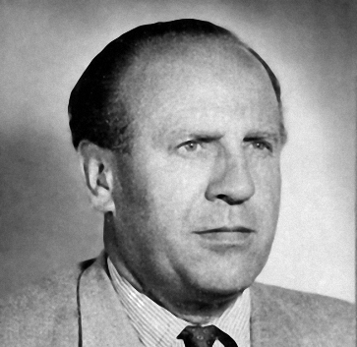
Even though there was widespread anti-Semitism in Europe, there were still those who risked their lives to help the Jews.
Some hid Jews in their homes, using hidden spaces or rooms.
Others helped Jews escape to a non-German controlled country.
Individuals who helped Jews faced execution or deportation to a camp.
Only a small percentage of Jews were saved by rescuers.
Most were too scared to help the Jews.
Bystanders were those who were too afraid to act against the Third Reich, even if they did not agree with the actions.
Some individuals physically fought back against the Nazi regime.
They were part of the resistance and were called partisans.
They hid in the forests and sabotaged railroads, aided those who escaped, and fired upon Nazi troops.
Jews were among the partisans.
Oskar Schindler
Notes:
*Copy the following link in your browser: https://www.ushmm.org/wlc/en/media_nm.php?MediaId=3374
It is an animated map that shows rescue movements. It is about 5 minutes long.
*Copy the following link in your browser: https://www.ushmm.org/wlc/en/media_nm.php?MediaId=3543
It is an animated map that shows resistance movements. It is about 2 ½ minutes long.

Slide 16
Many who survived were unable to return home.
Their homes had been taken over by non-Jews.
Their families were dead.
Many Jews were alone.
Anti-Semitism was still lingering.
Displaced Persons’ Camps
housed a large number of Jewish refugees
They waited to be allowed entry into countries like the United States, South Africa, Palestine, and others.
Creation of Israel
The United Nations voted to divide Palestine into a Jewish and Arab state.
The Jewish state became Israel in 1948.
Almost 700,000 Jews emigrated to Israel between 1948 and 1951.
Notes:
*Copy the following link in your browser: https://www.ushmm.org/wlc/en/media_nm.php?MediaId=3426
It is about the aftermath of the Holocaust. It is a little over 3 ½ minutes long.
*Copy the following link in your browser: https://www.ushmm.org/wlc/en/media_fi.php?MediaId=177
It is about a displaced persons’ camp. It is just under 1 minute long.

Slide 17
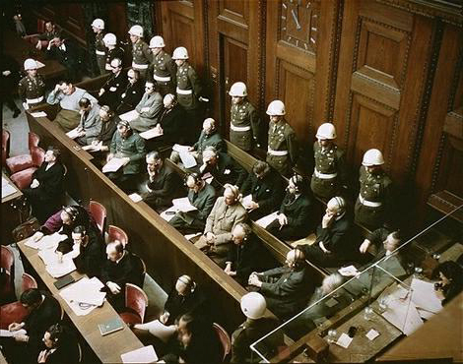
1945-1946
Twenty-two high-ranking German officials who were captured were put on trial in Nuremberg, Germany.
They were charged with genocide, a term that didn’t exist before 1944.
Hitler had committed suicide on April 30, when he realized a German defeat was imminent, so he did not face trial.
Outcome
12 were sentenced to death.
3 were acquitted.
The rest were sentenced to prison terms.
Why were only 22 tried?
Several Nazis fled Germany and escaped trial.
Notes:
*Copy the following link in your browser: https://www.ushmm.org/wlc/en/media_fi.php?MediaId=220
It shows some of the defendants entering pleas.
*Copy the following link in your browser: https://www.ushmm.org/wlc/en/media_fi.php?MediaId=191
It is Hermann Goering testifying.

Slide 18
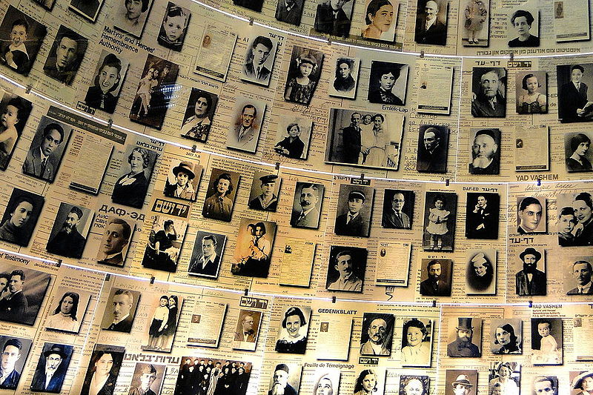
In 1953, the German government began making payments to the Jewish people.
This was to acknowledge the German people’s responsibility for the crimes committed against them.
Since the 1970s, Holocaust Remembrance has become important in many countries throughout the world.
commemorative events
education classes
books & magazine articles
movies & TV specials
Every major US city as at least one Holocaust museum or memorial.
There are over 250 museums and memorials worldwide.
The largest is the US Holocaust Memorial Museum in Washington, DC.
Hall of Names in Holocaust Museum in Jerusalem, Israel

