Slide 1
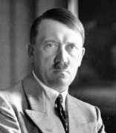
September 1939 – September 1945
Battles were fought in Europe, north Africa, and the Pacific.
Germany was very successful at the beginning of WWII.
Adolf Hitler had conquered most of Europe.
Notes:
**Click on the photo. The photo is a link to http://www.fortmissoula.org/exhibits/ww/WWIImap.shtml
Click on the image that matches the photo above. It downloads a ppt that shows the progression of WWII from start to end in Europe.
**Click on the map. The map is a link to http://www.worldology.com/Europe/world_war_2_imap.htm
The map is an interactive map of the progression of WWII, including some key battles.
**Click on the video. The video is a link to Kahn Academy at https://www.khanacademy.org/humanities/history/euro-hist/wo/v/1940-axis-gains-momentum-in-world-war-ii
The video is about the progression of WWII in Europe.

Slide 2
After conquering most of Europe, Hitler looked to conquer Great Britain.
Great Britain was the last major European country left to fight Germany.
Once Hitler defeated Great Britain, he could turn his attention to the Soviet Union.
YES, Hitler and Stalin signed a nonaggression pact.
YES, Hitler is going to stab Stalin in the back!!!
Great Britain is an island, separated from mainland Europe by the English Channel.
Hitler’s Plan
Airstrikes to take out Britain’s Royal Air Force (RAF).
Without air support, Britain’s navy would be easily defeated.
Began July 10, 1940
First, Germany’s air force, the Luftwaffe, attacked RAF bases.
Next, on, Sept. 7, the Luftwaffe began bombing large cities like London.
Notes:
**Click the map. This video is a link to Kahn Academy at www.khanacademy.org/humanities/history/euro-hist/ww1-aftermath/v/more-detail-on-the-treaty-of-versailles-and-germany
This video discusses the aftermath of the Treaty of Versailles and Germany.

Slide 3
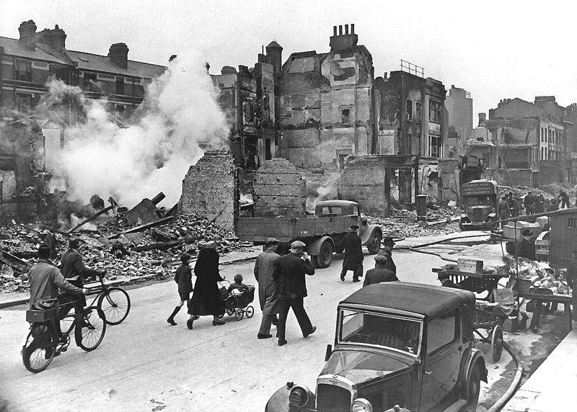
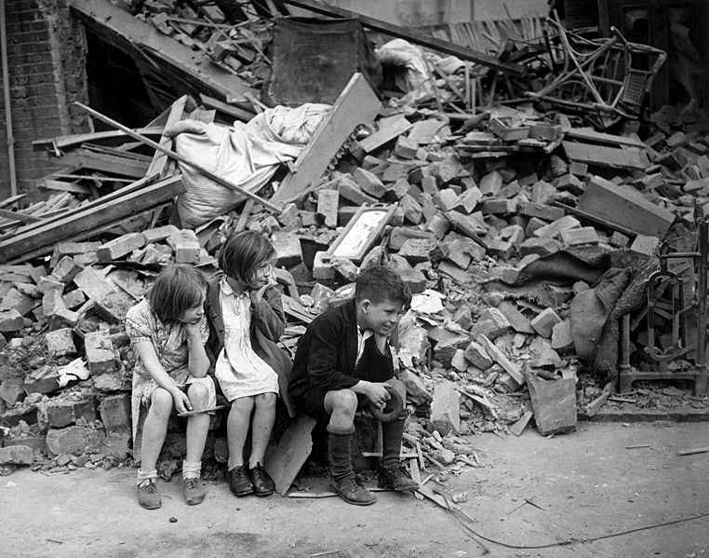
Many civilians were killed, and towns were devastated.
Great Britain WON!!!!
Even though Great Britain suffered great damage to RAF bases and towns, the British did not give up.
RAF used radar to detect incoming Luftwaffe.
The Blitz
For 57 nights in a row, the Luftwaffe bombed London.
Hitler continued bombing London at night until May 1941.
Hitler still bombed London at times, but he needed his Luftwaffe to attack the Soviet Union instead.
Notes:
**Click the map. This map is a link to http://www.historyanimated.com/wwiianimated.com/BritainAnimation.html
It’s an animated map that starts with Hitler’s speech when he was elected Chancellor of Germany. You can select the “Battle of Britain” at the bottom of the map to jump forward to this clip.
**Click on the photo. This photo is a link to http://www.history.com/inside-wwii-interactive
It’s an interactive show to different aspects of WWII. Hover over the Battle of Britain and click it. This has information about the battle, two audios (one from Winston Churchill), and a photo slideshow of the battle.
**Click on the photo. This photo is a link to an interactive site at http://www.bbc.co.uk/guides/zgs34j6#z93cdmn
You can click through the page to read more about RAF pilots, simulate a dogfight, and learn more about the Battle of Britain.

Slide 4
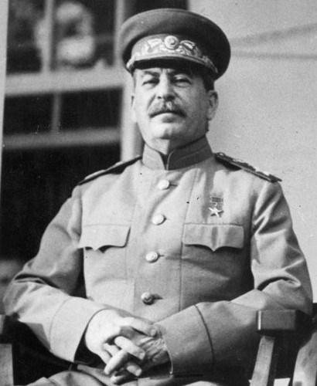
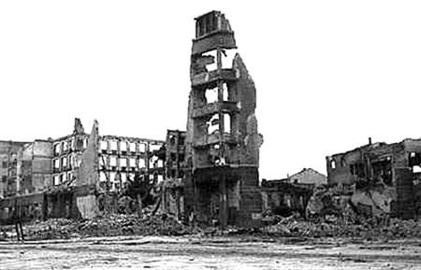
Hitler had already invaded western Soviet Union in summer 1941.
One of the bloodiest battles in history: over 1.2 million killed
Important for Germany:
Important for the USSR:
easily launch attacks on the rest of the Soviet Union from this city
major industrial and communication city
give a psychological blow to the Soviets because the city was named after Soviet dictator Stalin.
bore Stalin’s name
Began July 17, 1942
German troops reach the city on Sept. 3.
Luftwaffe bombed the city before ground troops moved in.
By late September, Germany had reached the city center.
Notes:
**Click on the video. The video is a link to Kahn Academy at https://www.khanacademy.org/humanities/history/euro-hist/wo/v/1941-axis-momentum-accelerates-in-ww2
The video is about continued takeover of Europe by the Axis Powers. At the 5:40 mark until 7:20, it gets specifically into Hitler breaking the nonaggression pact with the Soviet Union.
**Click on the video. The video is a link to Kahn Academy at https://www.khanacademy.org/humanities/history/euro-hist/wo/v/1942-tide-turning-in-world-war-ii-in-europe
The video is about the turning of the tide in WWI from the Axis Powers to the Allied Powers. At the 0:45 mark it begins to talk about the war in Europe. At the 1:42 mark until 3:00 it talks specifically about the Battle of Stalingrad.

Slide 5
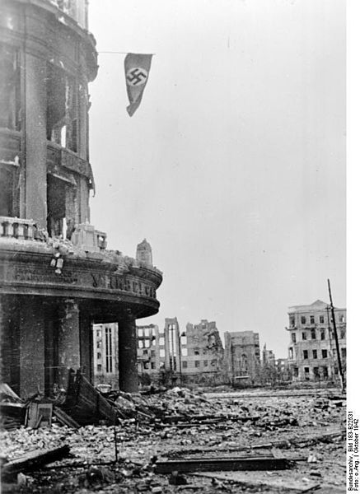
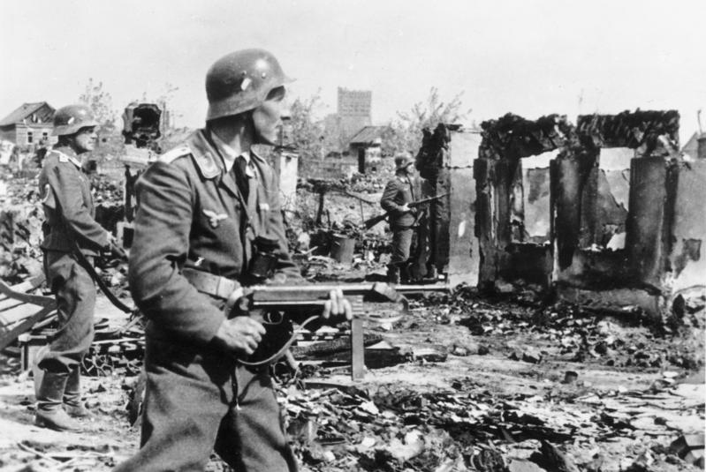
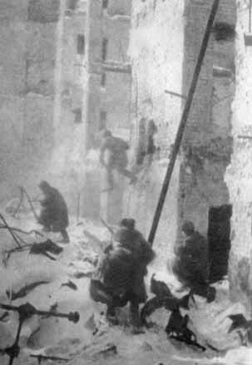
Germany had occupied 90% of the city.
The swastika flag flies from a Soviet building.
German soldiers continue to overtake the city.
However, the Soviets would not give up.
Soviet troops hid in buildings, rubble, and sewers.
They attacked German troops relentlessly.

Slide 6
By mid-November the German troops were running low on ammunition and food.
The Soviets surrounded the German troops and cut off supplies.
The Germans suffered in the harsh Soviet winter.
Soviet Union WON!!!!
The remaining 91,000 Germans surrendered on Feb. 2, 1943.
Results
Severe humiliation for Hitler.
Confidence boost for Stalin.
The German army suffered terrible losses.
The German army never fully recovered.
Germany would never conquer the Soviet Union.
The Soviets would soon push Germany out of the Soviet Union.
Notes:
**Click on the video. The video is a link to Kahn Academy at https://www.khanacademy.org/humanities/history/euro-hist/wo/v/1943-axis-losing-in-europe
The video is about the Allied Powers taking control of WWII, starting with the German loss at the Battle of Stalingrad from the beginning to the 0:45 mark.

Slide 7
Even after the losing the Battle of Britain and Stalingrad, Hitler still controlled most of Europe.
Allied Powers needed to get a foothold in mainland Europe to push Germany back.
American and British began launching airstrikes in German held territories to slow down German troops.
June 6, 1944: D-Day
Germany knew the Allies were planning an invasion, but they didn’t know where.
The Allies made it look like they were going to invade north of Normandy, at Pas de Calais.
First Wave of Attack
Paratroopers parachuted behind German lines at night.
They secured bridges and exit roads.
Dummies were dropped out of planes to trick the Germans.

Slide 8
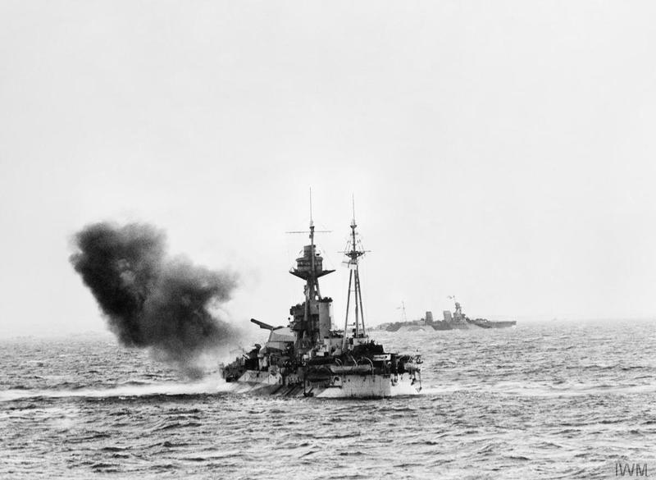
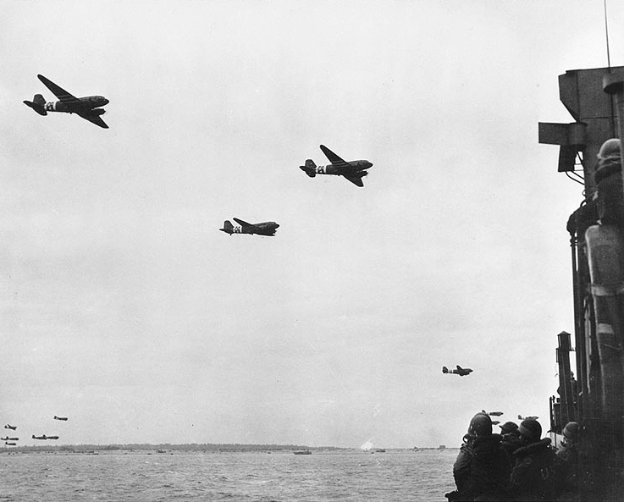
Second Wave of Attack
Warships bombed the beaches from the sea.
Allied planes bombed German defenses.
French Resistance members cut telephone lines and destroyed bridges to slow German troops.

Slide 9
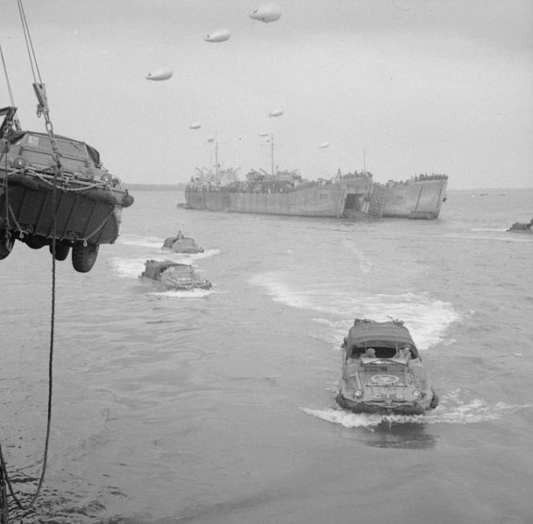
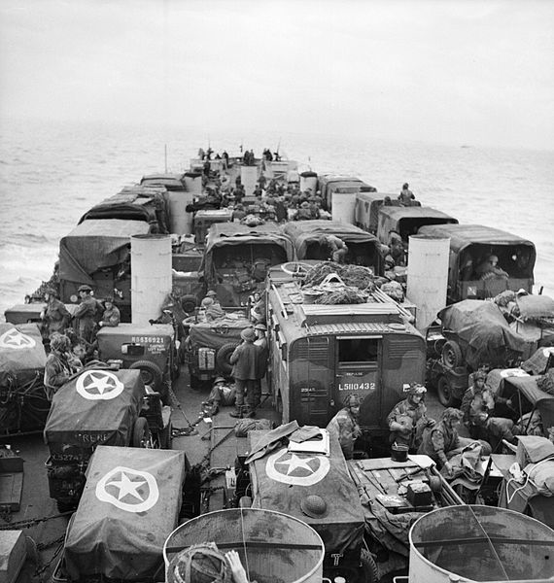
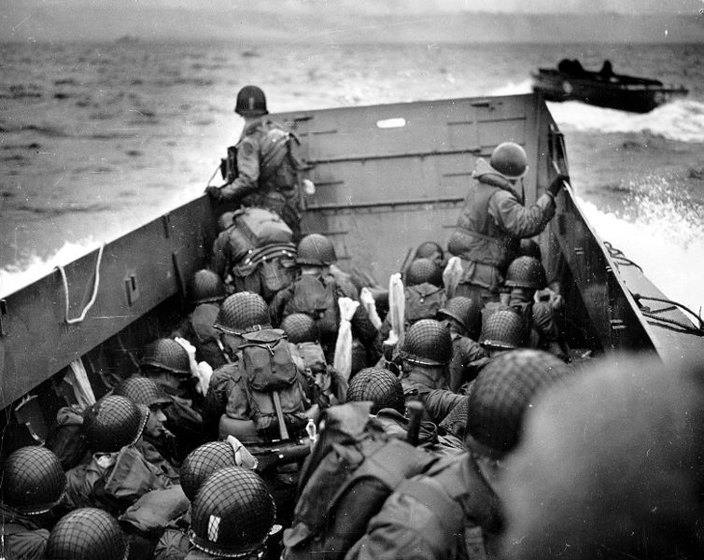
Over 5,000 ships
150,000 troops
Over 11,000 aircraft
Troops from the US, Great Britain, and Canada
British
Canadian
American
Gold Beach
Sword Beach
Juno Beach
Sword Beach
Utah Beach
Omaha Beach
Omaha Beach was the bloodiest of the D-Day beaches.
Notes:
**Click on the animated map. The map is a link to http://www.bbc.co.uk/history/interactive/animations/wwtwo_map_d_day/index_embed.shtml
This shows the stages of the D-Day landings.
**Click on the photo. The photo is a link to History Channel at http://www.history.com/topics/world-war-ii/d-day/videos/dday-invasion
The video is about the beginning of D-Day.

Slide 10
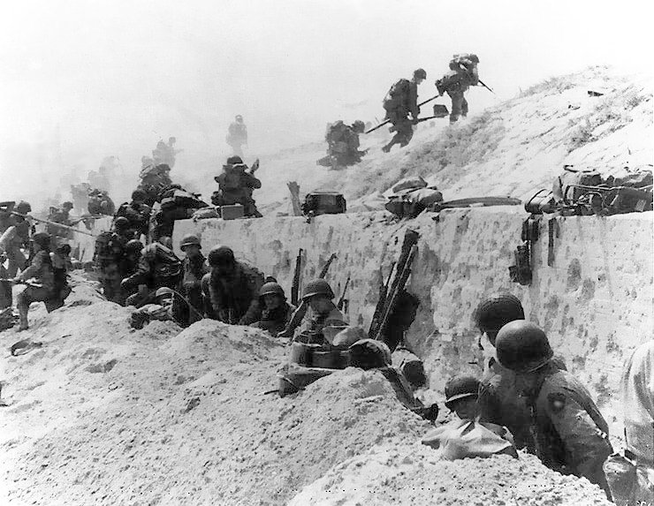
By June 17, over 500,000 Allied soldiers were pushing the Germans out of France.

Slide 11
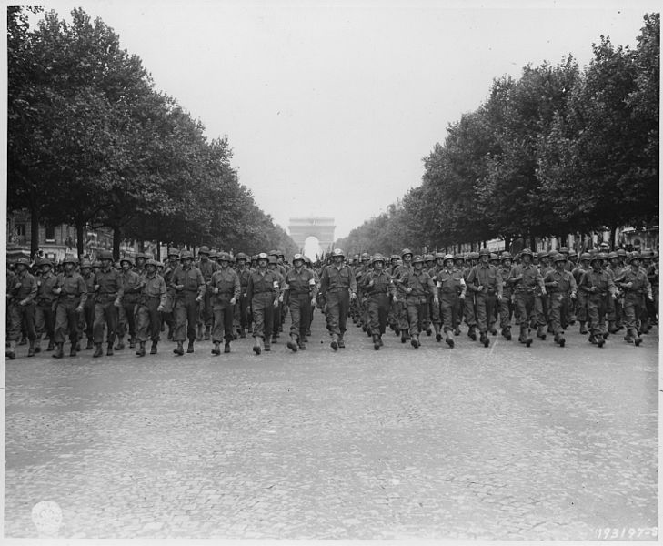
By the end of August, northern France was liberated.
American troops marching in Paris after France was liberated.
Allies WON!!!!
French tanks and troops marching in Paris after France was liberated.
Germany now had to fight on its west and east.
Notes:
**Click on the animated map. The map is a link to http://www.bbc.co.uk/history/interactive/animations/wwtwo_map_overlord/index_embed.shtml
This shows how the Allied troops pushed back Germany and liberated France.
**Click on the video. The video is a link to http://www.bbc.co.uk/history/interactive/animations/wwtwo_movies_dday/index_embed.shtml
This video is about the invasion at Normandy and how the Allies pushed the Germans back and liberated France.
**Click on the video. The video is a link to Kahn Academy at https://www.khanacademy.org/humanities/history/euro-hist/wo/v/1944-allies-advance-further-in-europe
The video is about the invasion at Normandy and the liberation of France from the 1:30 mark to the 2:04 mark.

Slide 12
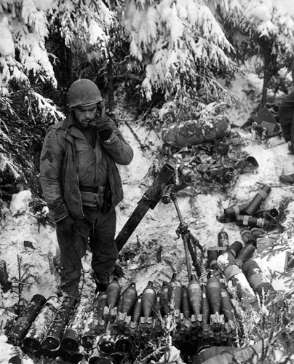
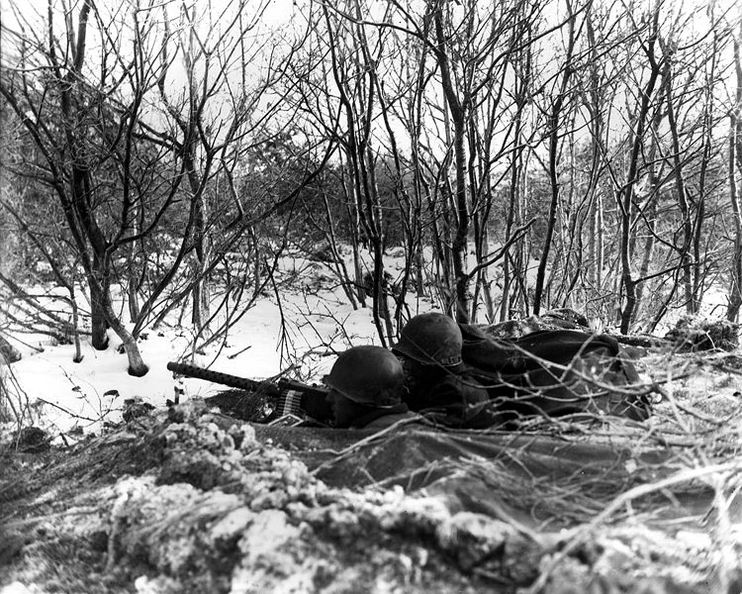
One of the last major battles fought in Europe.
Hitler’s last chance to force the Allies off mainland Europe.
Considered one of the greatest battles fought by the US military.
Began Dec. 16, 1944
Germany used a blitzkrieg to attack the Allied troops in the Ardennes Forest of Belgium.

Slide 13
Germany attacked the center of the Allied front line.
The Allied front line was pushed back creating a bulge.
Over 200,000 Germans troops and 1,000 tanks broke through.
Allies were caught off guard and thousands were killed.
But that’s not all…..
English speaking German spies were dropped behind the Allied front line.
These German spies were dressed in American uniforms and told lies to confuse the Allied troops.
Things weren’t looking good for the Allies.
Allied troops refused to give up.
Allied troops destroyed German fuel reserves, so the Germans began to run out of fuel for their tanks.
The Battle of the Bulge lasted about one month.
About 100,000 American casualties.

Slide 14
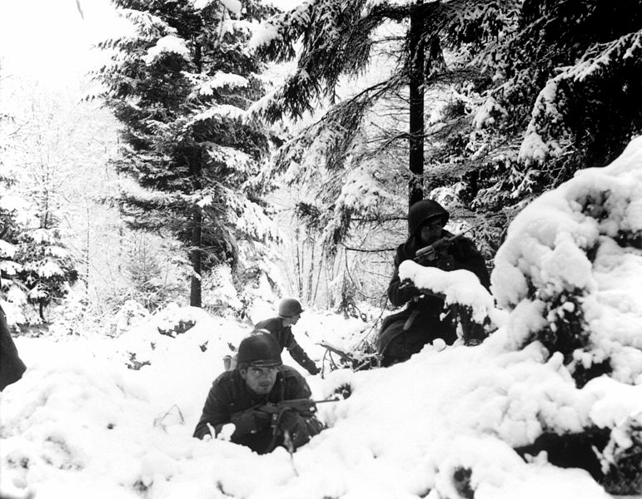
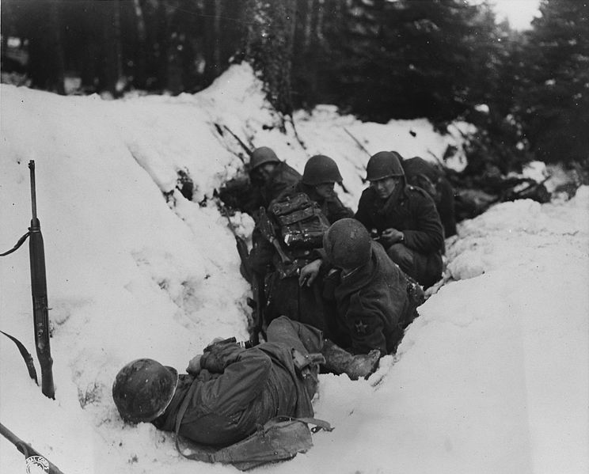
Allied troops fought until reinforcements came.
Hitler’s last chance at pushing the Allies off mainland Europe failed.
Allies WON!!!!
Notes:
**Click on the photo. The photo is a link to the History Channel at http://www.history.com/topics/world-war-ii/world-war-ii-history/videos/battle-bulge
It is about the Battle of the Bulge.
**Click on the video. The video is a link to Kahn Academy at https://www.khanacademy.org/humanities/history/euro-hist/wo/v/1944-allies-advance-further-in-europe
The video is about the Battle of the Bulge beginning at the 5:10 mark

Slide 15
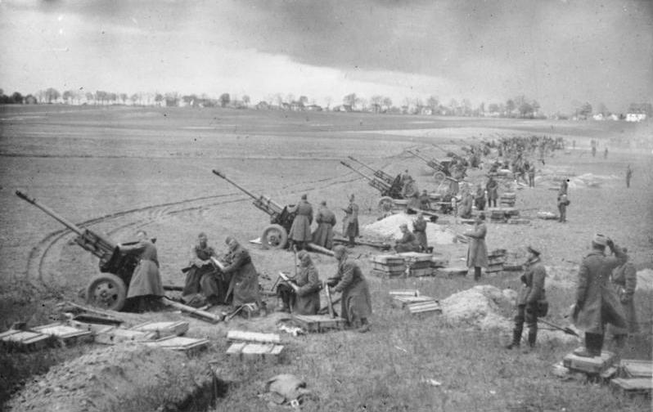
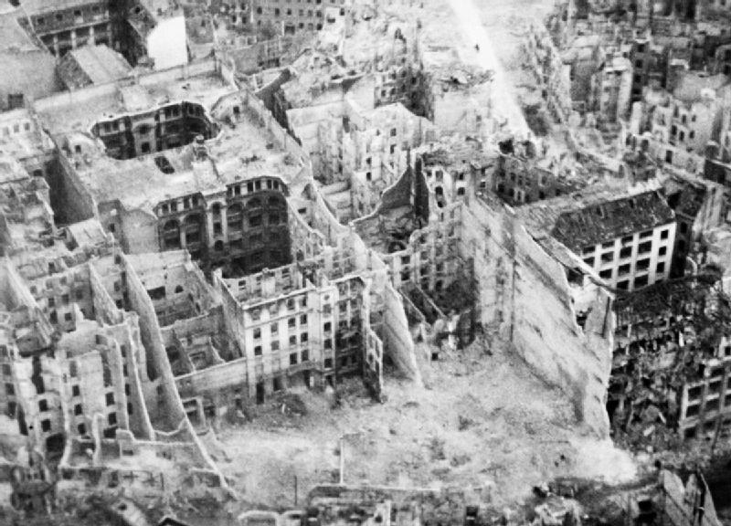
Last major battle fought in Europe.
Primarily between German and Soviet troops.
Soviet troops greatly outnumbered the Germans.
Began April 16, 1945
Soviet Union
Germany
2.5 million soldiers
1 million soldiers
7,500 aircraft
2,200 aircraft
6,200 tanks
1,500 tanks
German soldiers were starving, sick, and wounded from years of fighting.
The Soviets were able to attack the city and easily surround it.
On April 20, the Soviets began bombing the city.

Slide 16
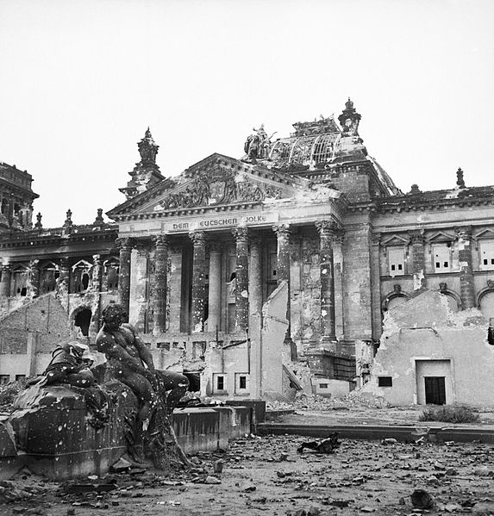
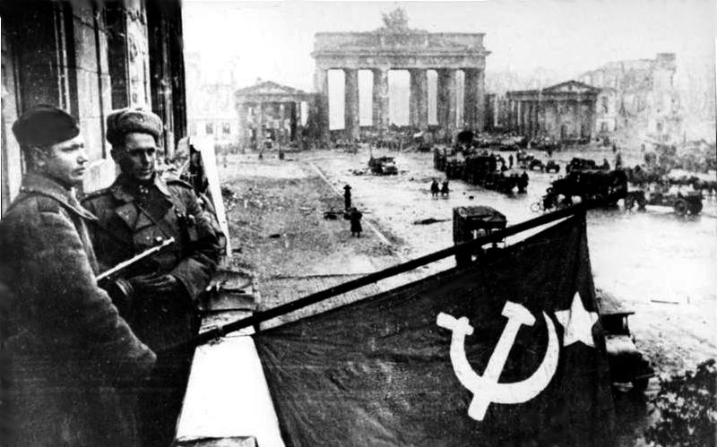
Hitler knew Berlin was going to fall.
He called in additional German troops from the west.
By April 30, Berlin lay in ruins.
Soviet soldiers raising the Soviet flag in Berlin.
Reichstag government building
The Soviets were closing in.
Hitler knew he had lost.
Hitler knew Germany had lost.
Notes:
**Click on the video. The video is a link to Kahn Academy at https://www.khanacademy.org/humanities/history/euro-hist/wo/v/1945-end-of-world-war-ii
The first 3 minutes are about the ending of the war in Europe.

Slide 17
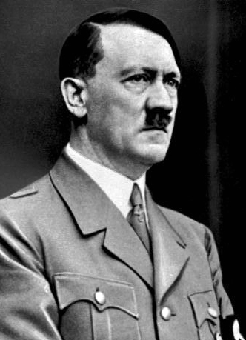
On April 30, Hitler committed suicide instead of being taken prisoner.
On May 2, German generals surrendered.
Allies WON!!!!
VE Day
Victory in Europe
May 8, 1945
The remaining Nazi leaders signed their surrender to the Allies.
When the battle ended, there were:
360,000 Soviet casualties
310,000 German casualties
22,000 German civilians were killed
The war in Europe is over, but it still raged on in the Pacific
Notes:
**Click on the video. The video is a link to Kahn Academy at https://www.khanacademy.org/humanities/history/euro-hist/wo/v/1945-end-of-world-war-ii
The first 3 minutes are about the ending of the war in Europe.
**Click on the video. The video is a link to the History Channel at http://www.history.com/topics/world-war-ii/world-war-ii-history/videos/truman-announces-germanys-surrender
It is Truman’s speech of Germany surrendering.

