Slide 1
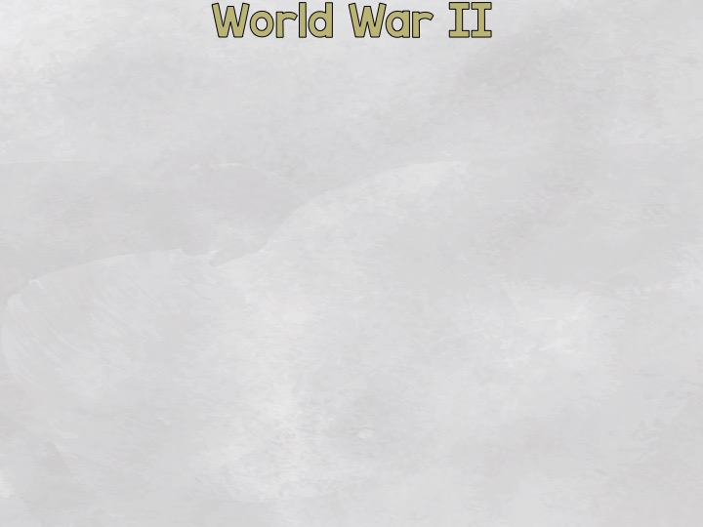
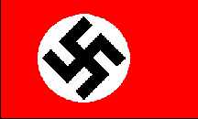
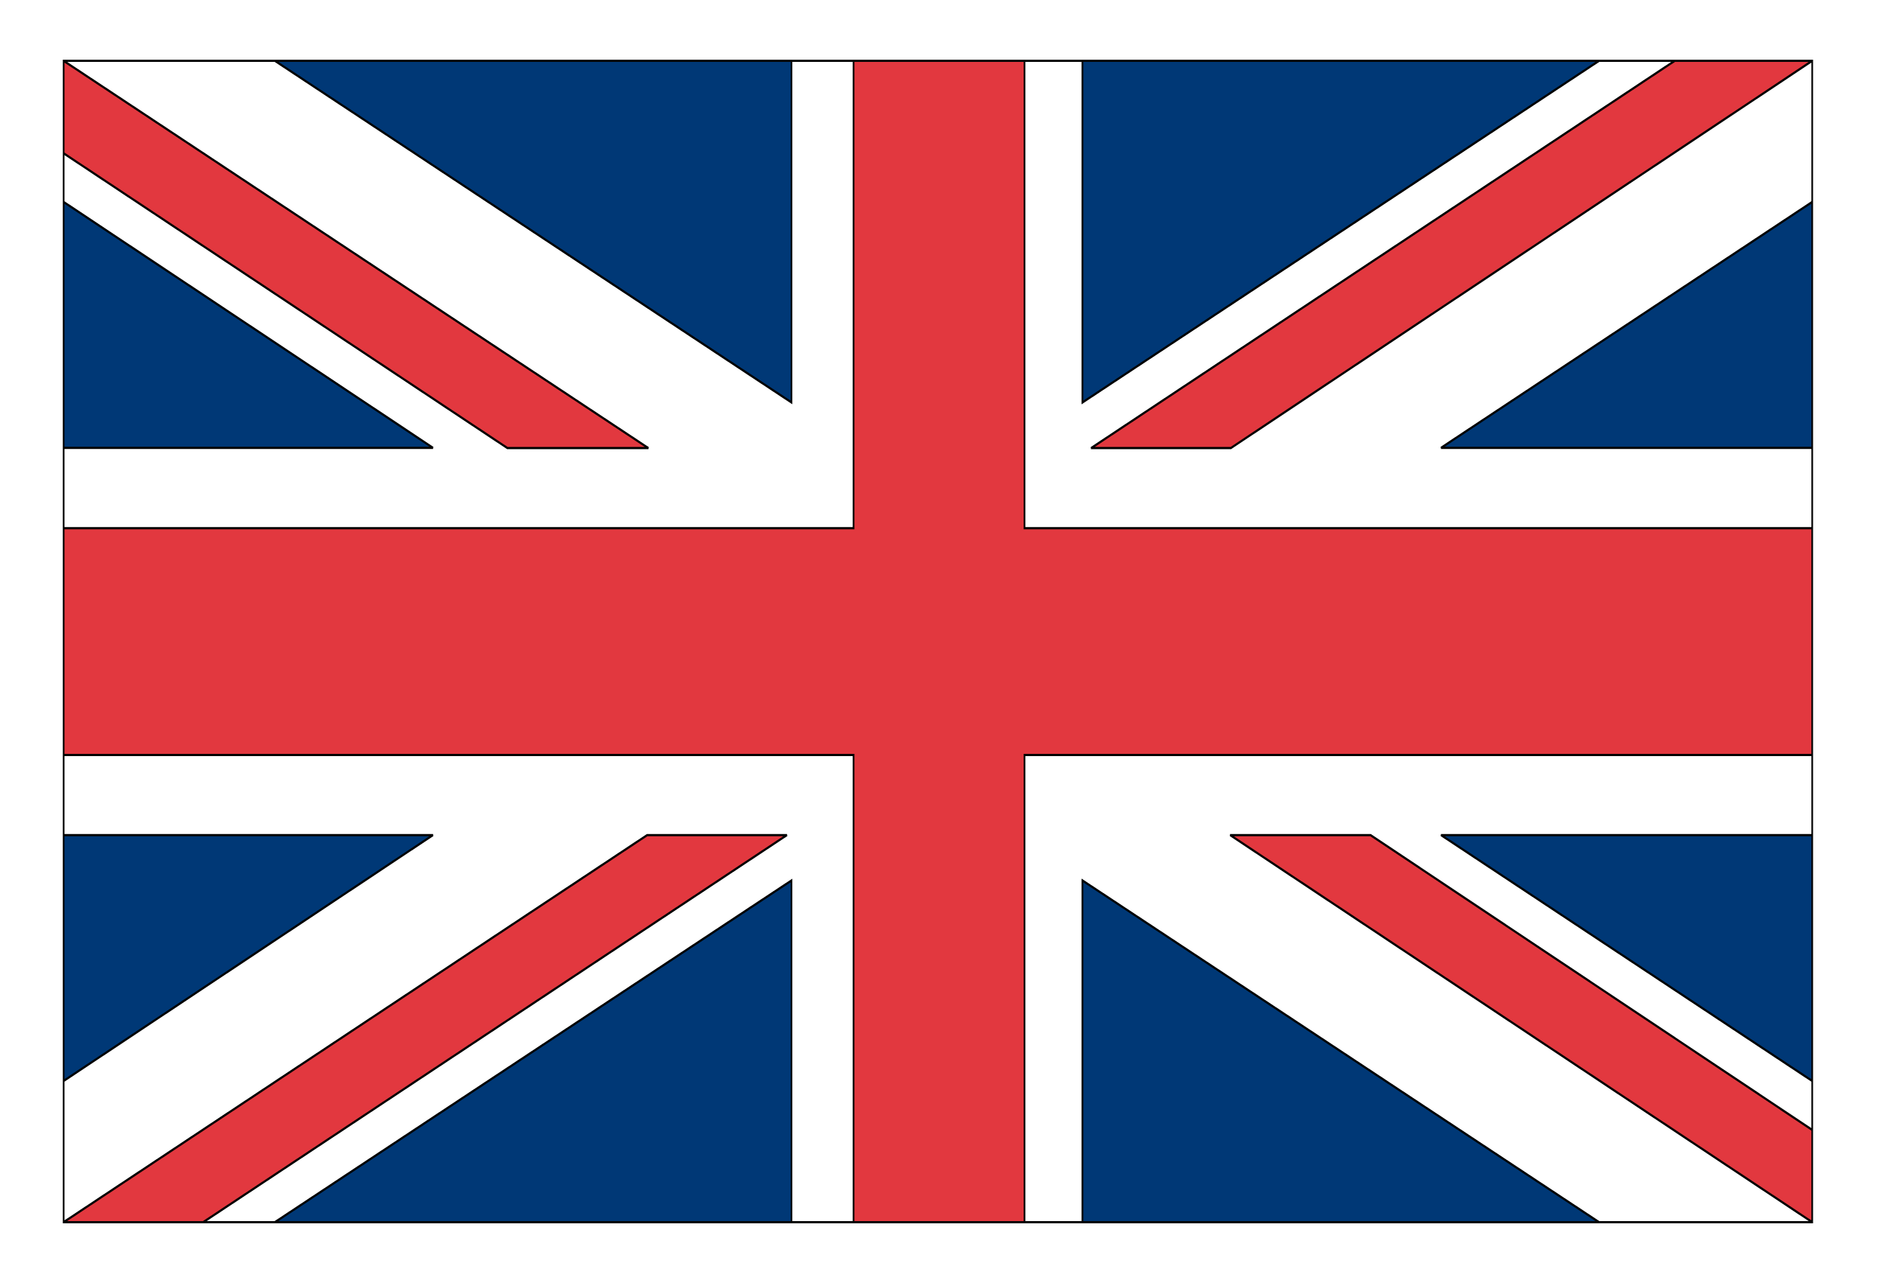
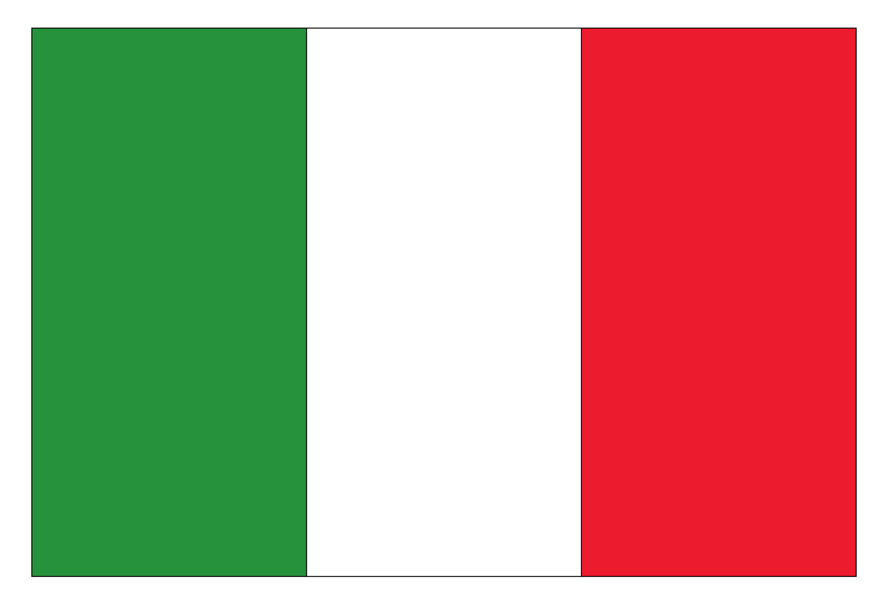
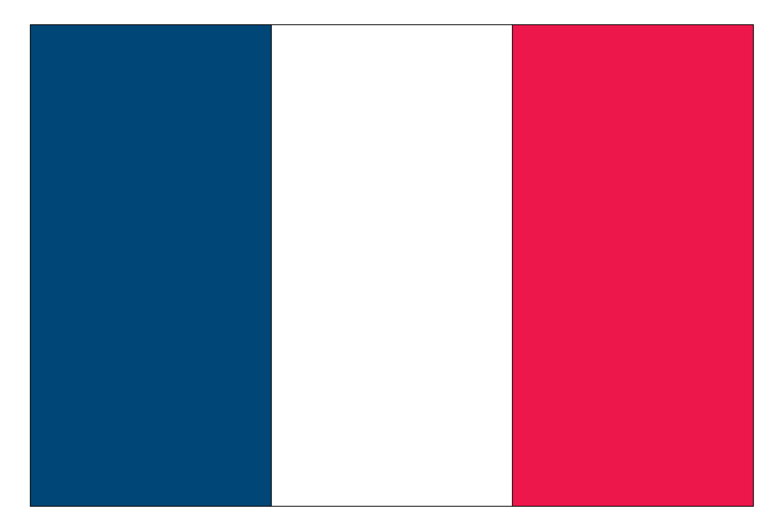
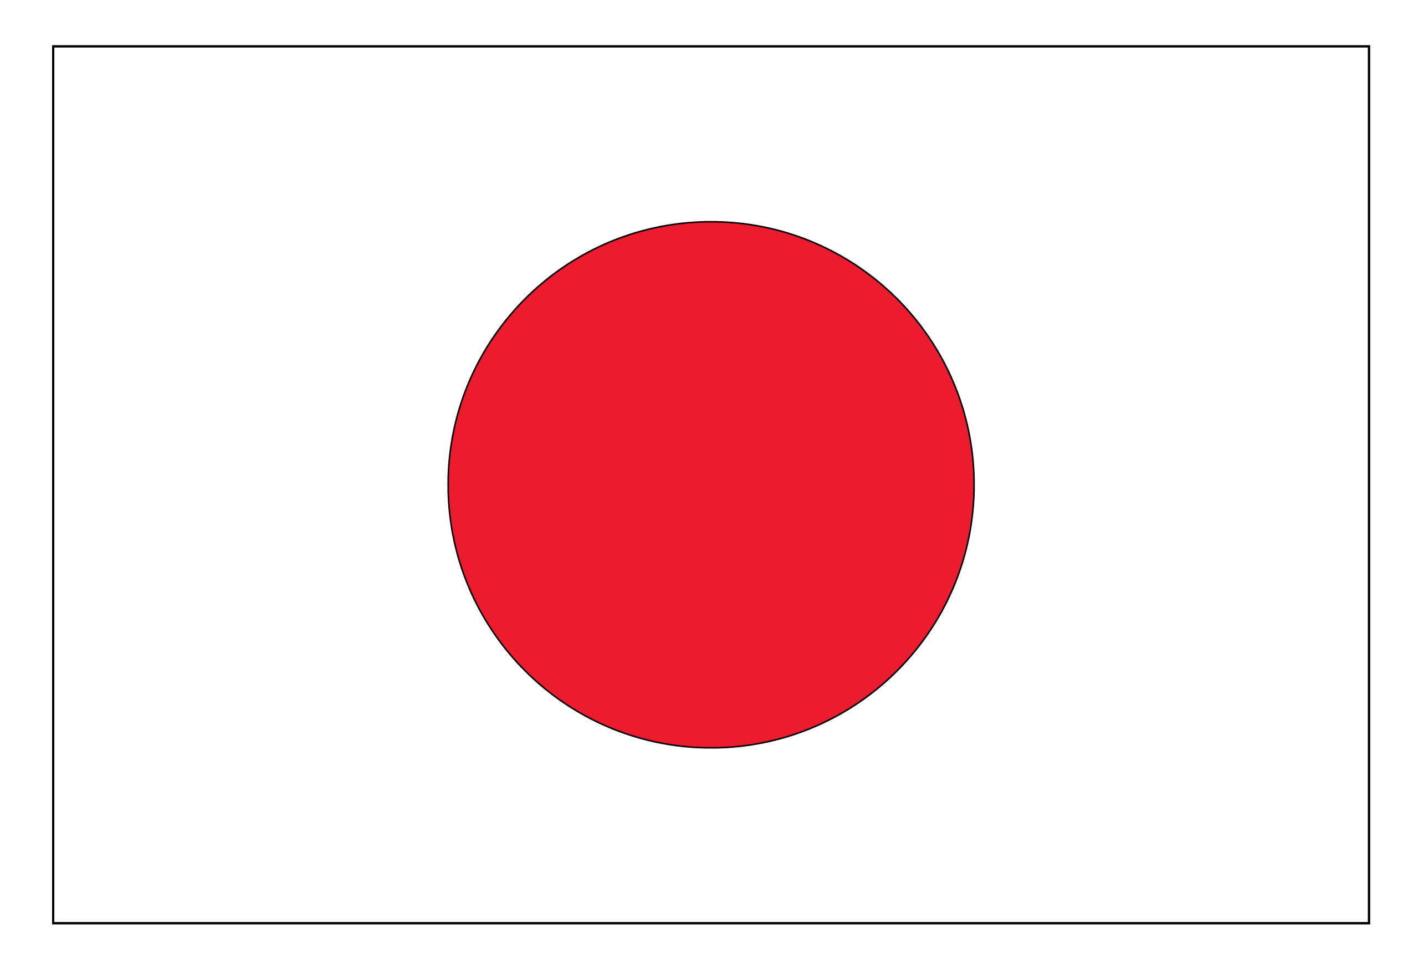
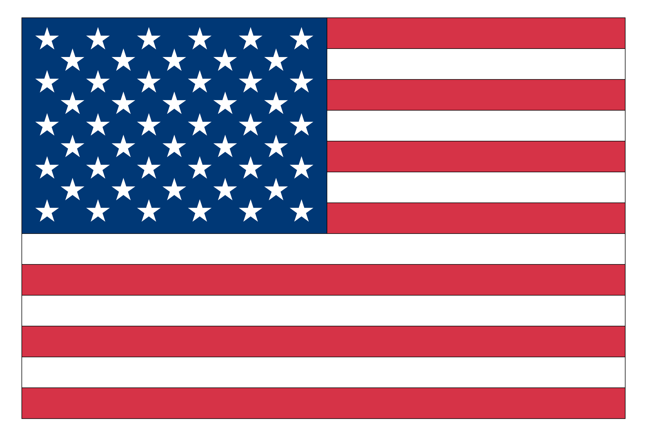
September 1939 – September 1945
Axis Powers vs. Allied Powers
Germany
Great Britain
Italy
France
Japan
Soviet Union
Joined June 1941
United States
Joined Dec. 1941
© 2016 Brainy Apples/Heather LeBlanc, LLC

Slide 2
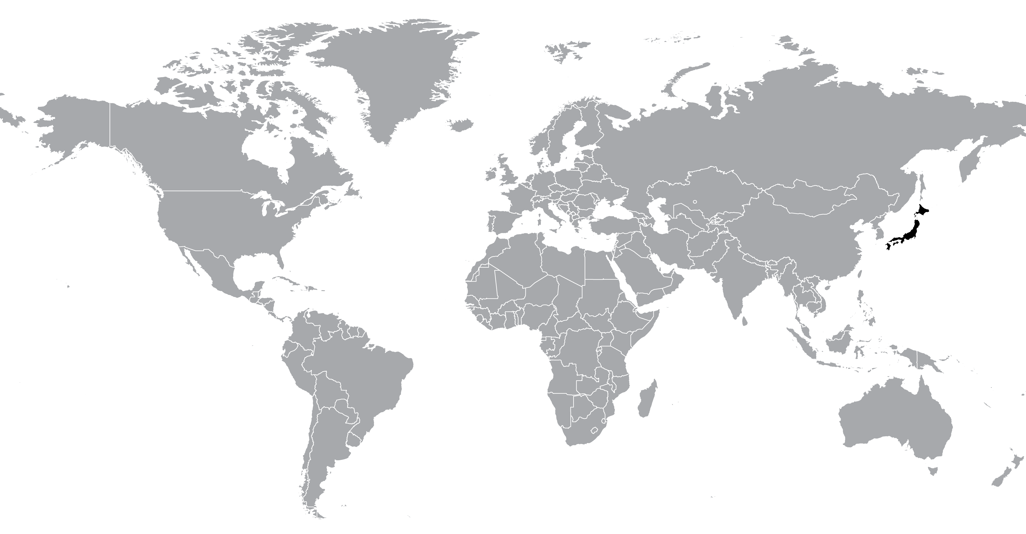
Small island
Lacked natural resources
Japan could not become a world power
Solution
Conquer other countries!
Battles were fought throughout the Pacific including:
Japan
Korea
many more small islands
China
Philippines
Notes:
**Click on the map. It is a link to Kahn Academy at https://www.khanacademy.org/humanities/world-history/euro-hist/wo/v/beginning-of-world-war-ii
This video is about Japan entering WWII. Begin at the 0:25 mark until the 3:30 mark.
**Click on the video. This is a link to Kahn Academy at https://www.khanacademy.org/humanities/world-history/euro-hist/wo/v/1940-axis-gains-momentum-in-world-war-ii
This video is about Japan entering into an alliance with the Axis Powers. Begin at the 3:40 mark until the 4:40 mark.

Slide 3
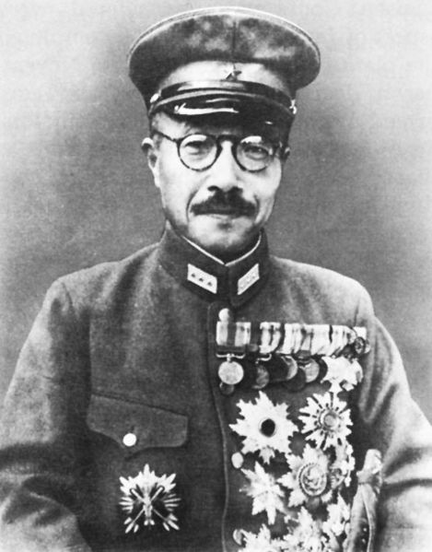
Already invaded Manchuria when WWII started in Europe
1941- Hideki Tôjô, an army general, becomes Prime Minister
Tôjô wanted to attack the US.
What?
Why?
The US was neutral, but Tôjô wanted to ensure the US could not stop Japan from invading countries in the future.
Tôjô decided to attack the US Navy and sink enough ships to keep the US from challenging Japan.
Notes:
**Click on the video. It is a link to Kahn Academy at https://www.khanacademy.org/humanities/world-history/euro-hist/wo/v/1941-axis-momentum-accelerates-in-ww2
This video is about Japan’s aggression towards the US and Pearl Harbor. Begin at the 7:20 mark until the 10:10 mark.
From 10:10 until the end of the video is Japan’s continued attacks.

Slide 4
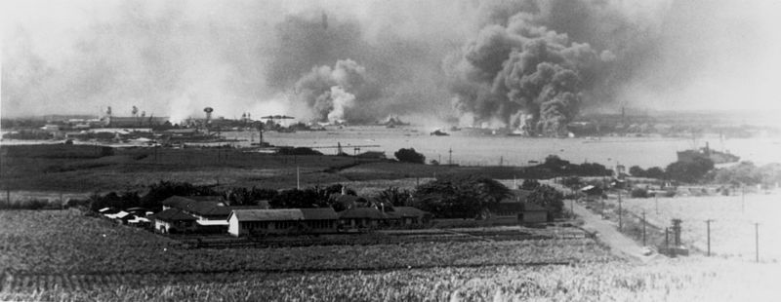
Dec. 7, 1941
Japanese fighter pilots attack the US Pacific Fleet in Hawaii
US was surprised and not prepared!
USS Arizona 1,000 men were trapped inside
Pearl Harbor attacked; 3,000 American casualties
Notes:
**Click the video. The video is a link to National Geographic at http://www.nationalgeographic.com/pearlharbor/ax/frameset.html
This video is an animation of the attack of Pearl Harbor.

Slide 5
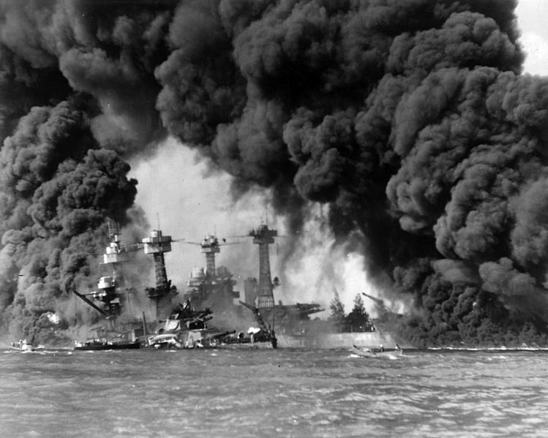
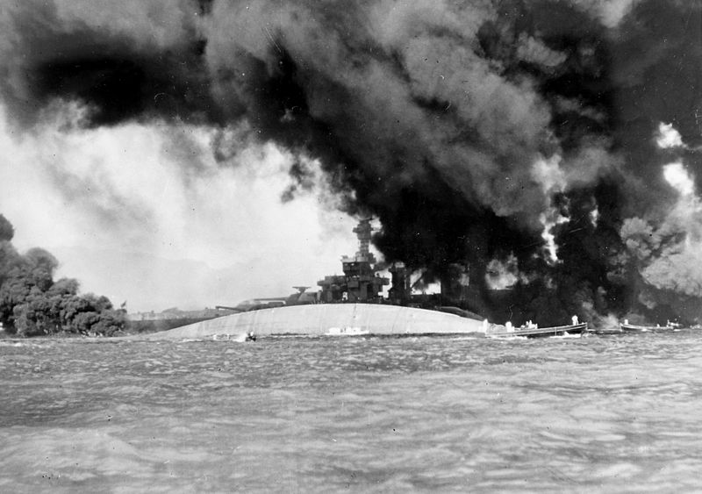
In 2 hours, 20 naval vessels were destroyed, including 8 battleships
USS Arizona was the first battleship to sink
more than 300 airplanes were destroyed
US entered WWII on Dec. 8
USS West Virginia
USS Tennessee
USS Oklahoma is capsized
USS Maryland in the back
Japan’s plan backfired

Slide 6
Japan was not successful
Why?
Aircraft carriers were viewed as the most important naval vessel.
The US aircraft carriers were not at Pearl Harbor during the attack.
Japan also failed to destroy:
oil storage facilities
shipyards
submarine docks
So the US was able to recover quickly
What DID Japan do?
Awaken the “Sleeping Giant”
Notes:
**Click on the video. The video is a link to History Channel at http://www.history.com/topics/world-war-ii/pearl-harbor/videos
There are 5 short videos ranging from 2-5 minutes about Pearl Harbor.

Slide 7
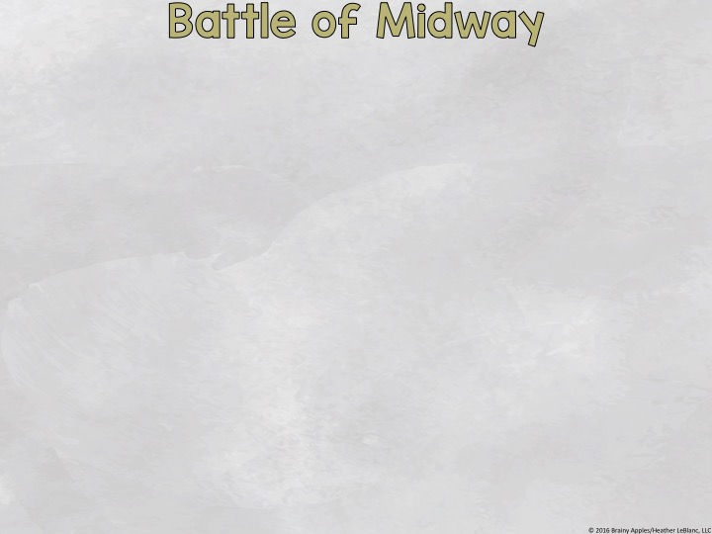
June 3, 1942- Japan attacks the Aleutian Islands to create a diversion from their real target:
The US was not tricked.
The US knew the Imperial Fleet would attack Midway because they had broken the Japanese naval code.
The US Pacific Fleet had battleships placed in strategic places waiting for the Japanese Imperial Fleet.
Notes:
**Click on the video. The link is to Kahn Academy at https://www.khanacademy.org/humanities/world-history/euro-hist/wo/v/world-war-ii-in-the-pacific-in-1942
This video discusses the Battle of Midway from the 3:30 mark until the 4:35 mark.

Slide 8
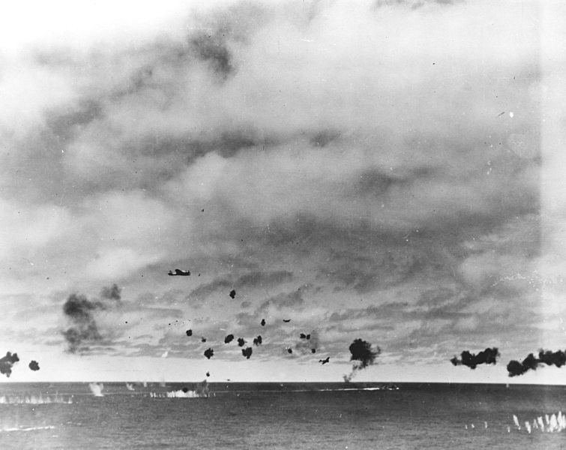
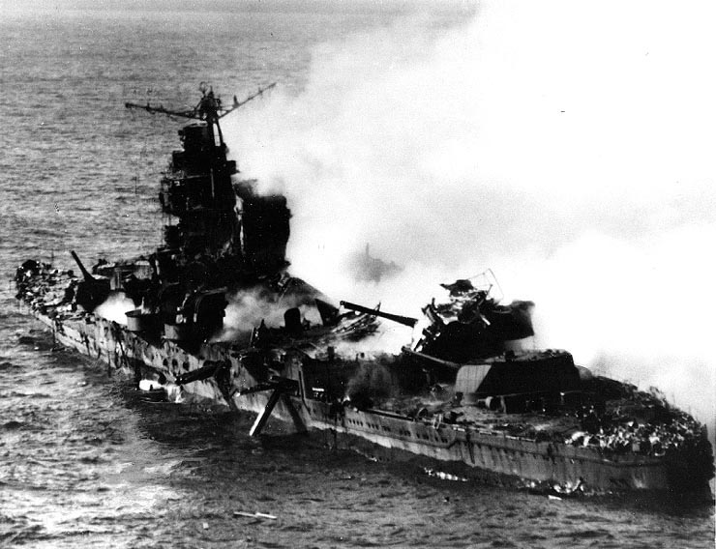
Turning point in the war
Japanese bombers
Pacific Fleet lost 147 aircraft & about 300 casualties
The US began attacking Japan
Japanese cruiser Mikuma
The battle lasted 3 days.
Japan gave up.
Imperial Fleet lost all 4 carriers, 250 aircraft, & over 5,000 casualties
Notes:
**Click on the map. It is a link to an animated map at http://pacificwaranimated.com/Midway.html

Slide 9
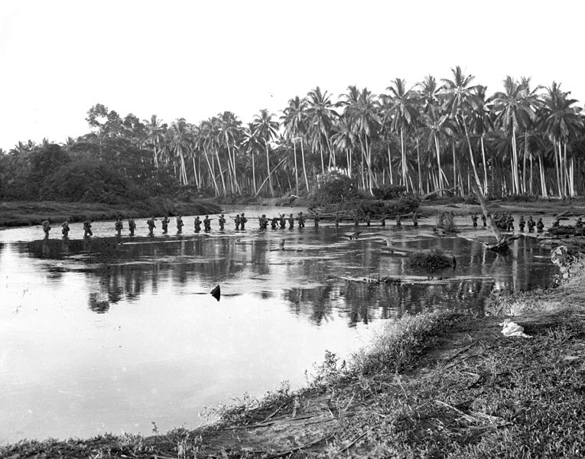
August 7, 1942 – February 9, 1943
Japan controlled most of Southeast Asia and was beginning to threaten Australia, a US ally.
First battle that the US attacked Japanese forces.
US surprised Japan, but Japan did not give up.
When US marines landed on the island, the Imperial Fleet sank Allied cruisers off the coast.
US patrol
US marines were isolated.
Japanese troops were sent in.
Notes:
**Click on the video. It is a link to Kahn Academy at https://www.khanacademy.org/humanities/world-history/euro-hist/wo/v/world-war-ii-in-the-pacific-in-1942
This video is about the Battle of Guadalcanal. Begin at the 4:35 mark until the end.

Slide 10
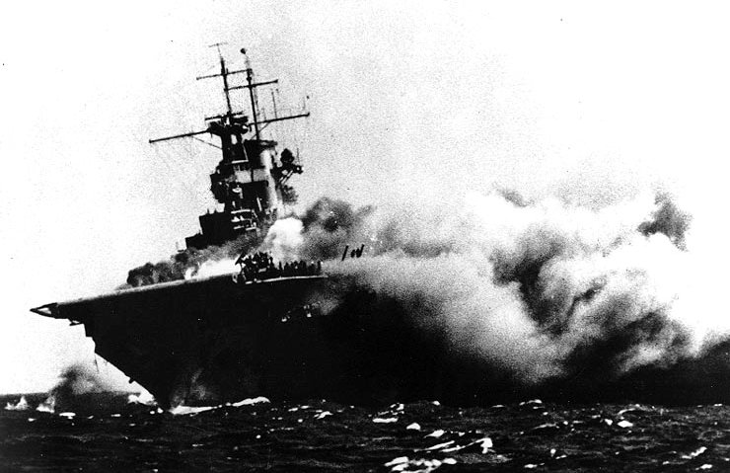
Australia no longer worried about a Japanese invasion
USS Wasp attacked by Japanese
In mid-November, Japan sent in an additional 10,000 troops.
The Japanese were unable to advance.
The Japanese had to retreat.
This loss marked the first time Japan lost land in WWII.
Japanese Losses:
Allied Losses:
31,000 casualties
7,100 casualties
38 ships
29 ships
Notes:
**Click on the map. It is a link to HBO at http://www.hbo.com/html/series/the-pacific/battlemaps/
Part 1 & 2 are about the Battle of Guadalcanal.
**Click on the map. It is a link to an animated map at http://www.pacificwaranimated.com/Guadalcanal.html

Slide 11
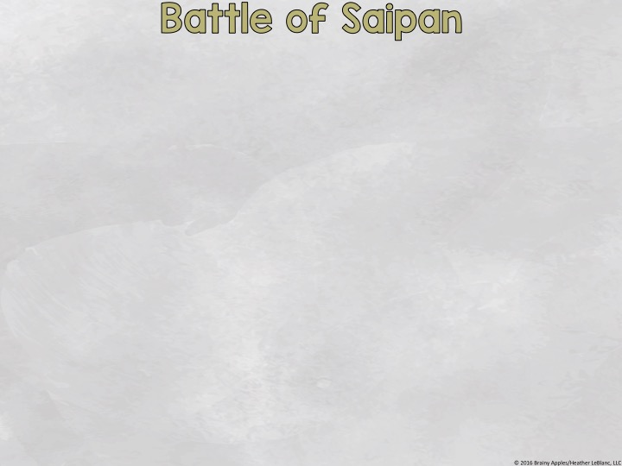
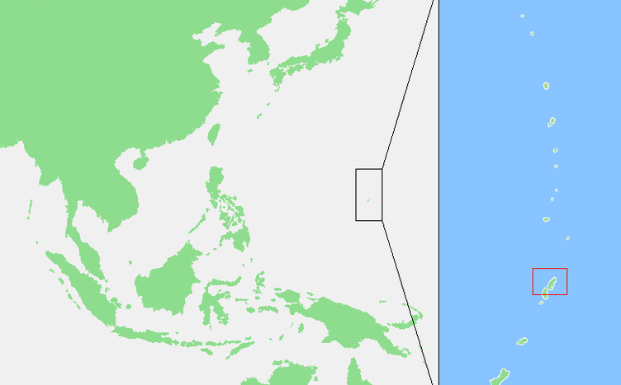
June 15, 1944 – July 9, 1944
US began island-hopping to take over Japanese-held islands on their way to Japan
US wanted control because the island’s airfields would be close enough to Japan to use its new B-29 bombers.
Japan wanted control to because they could stop the Allied advance.
When the Japanese commander knew defeat was imminent, he commanded his troops to launch a banzai attack.
July 6- 4,000 Japanese troops armed with swords, bayonets, grenades, and knives surprised Allied troops.
Largest banzai attack of WWII.
30,000 Japanese troops defended Saipan.
When the battle was over, less than 1,000 remained alive.
Many committed suicide, as did thousands of civilians.
Notes:
**Click the video. The video is a link to Kahn Academy at https://www.khanacademy.org/humanities/world-history/euro-hist/wo/v/american-progress-in-the-pacific-in-1944
The video discusses the US progress in the Pacific. Stop at the 5:35 mark.
**Click the video. It is a link to History Channel at http://www.history.com/topics/world-war-ii/world-war-ii-history/videos/battle-saipan
This short video is about the Battle of Saipan.

Slide 12
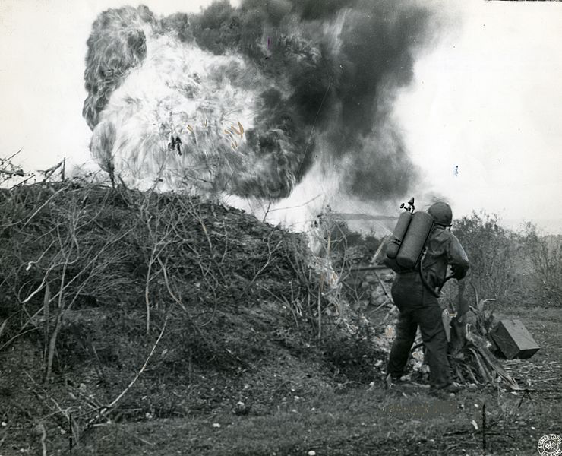
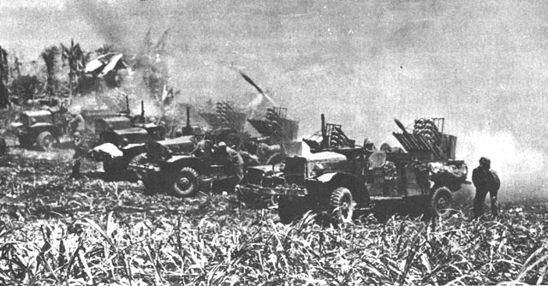
US continued to carve a path to Japan
Flamethrowers
Rocket launchers

Slide 13
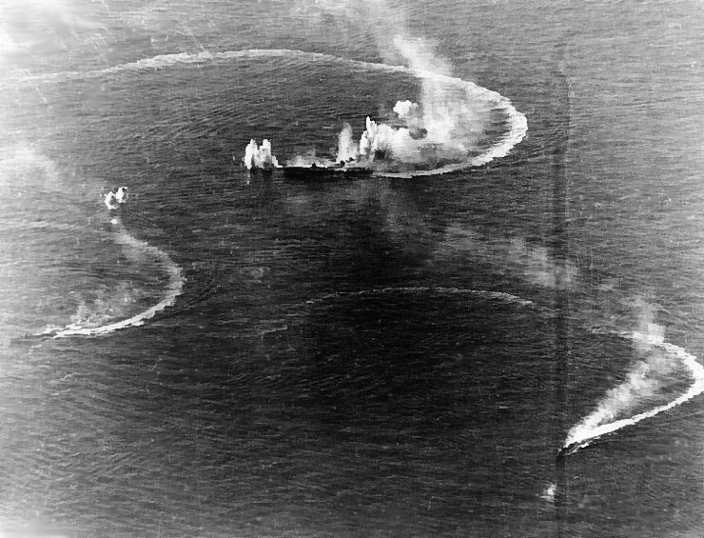
June 19, 1944 – June 20, 1944
Took place off the coast of Saipan
One of the biggest aircraft carrier battles of WWII
Huge victory for the Allies
Japanese aircraft carrier and naval vessels under fire
Imperial Fleet and Japanese air force were critically damaged.
Japan planned on delivering more troops to Saipan, but, with a loss in the Philippine Sea, the US controlled the seas around Saipan.
3 carriers were sunk and 400 aircraft were destroyed.
Notes:
**Click on the map. It is a link to an animated map at http://www.pacificwaranimated.com/PhillipineSea.html

Slide 14
October 23-26, 1944
Largest naval battle of WWII
Some consider it the greatest naval battle in history
This is the first battle the US witnessed kamikaze, or suicide, attacks.
Notes:
**Click the video. The video is a link to Kahn Academy at https://www.khanacademy.org/humanities/world-history/euro-hist/wo/v/american-progress-in-the-pacific-in-1944
The video discusses the Battle of Leyte Gulf. Start at the 5:35 mark.

Slide 15
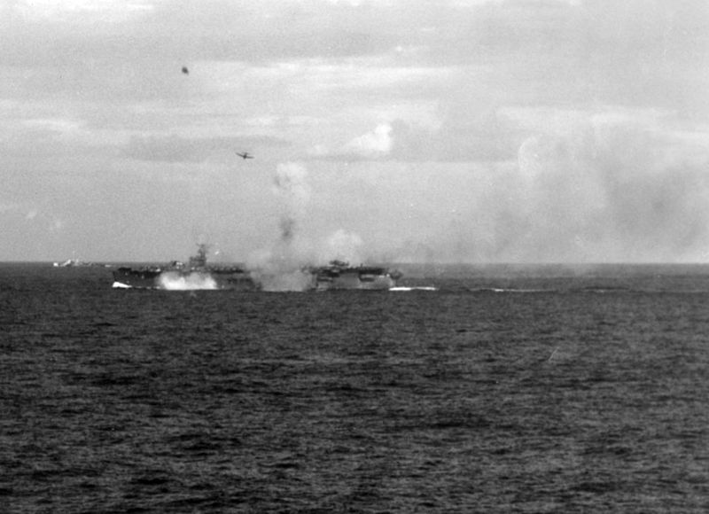
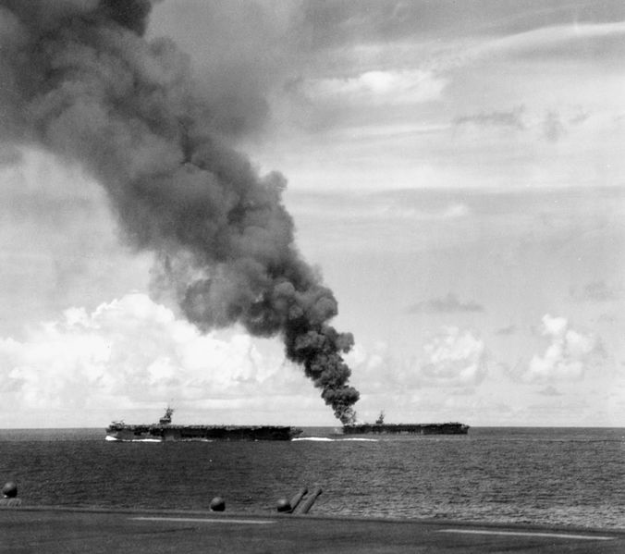
Japan lost MAJOR trade routes from Southeast Asia to its home islands
Japan’s Imperial Fleet was completely destroyed
US carriers under attack by Japanese airplanes
US carriers struck by kamikazes
Japanese Losses:
Allied Losses:
28 warships
5 warships
10,500 casualties
2,500 casualties
Allied forces were able to take control of the Philippines and had greater control of the Pacific.
Notes:
**Click the video. The video is a link to Kahn Academy at https://www.khanacademy.org/humanities/world-history/euro-hist/wo/v/american-progress-in-the-pacific-in-1944
The video discusses the Battle of Leyte Gulf. Start at the 5:35 mark.
**Click on the map. It is a link to an animated map at http://www.pacificwaranimated.com/PhillipineSea.html
This begins the same as the animated map for the Battle of the Philippine Sea, but it changes to focus on the Battle of Leyte Gulf.

Slide 16
February 19, 1945 – March 26, 1945
Memorialized with a monument in Washington, D.C.
Japan
Iwo Jima is only 5 miles by 2.5 miles.
Iwo Jima is a small island 750 miles south of Japan
Allied troops outnumbered Japanese troops, but the Japanese fought unrelentingly.
Iwo Jima War Memorial in Arlington, Virginia
Before Allied troops hit the ground, planes and battleships bombed the island.
When Allied troops landed, the Japanese didn’t attack them. The Allies thought most of the Japanese were dead.
Notes:
**Click the video. The video is a link to History Channel at http://www.history.com/topics/world-war-ii/battle-of-leyte-gulf/videos/battle-iwo-jima?m=528e394da93ae&s=undefined&f=1&free=false
This short video discusses the Battle of Iwo Jima.

Slide 17
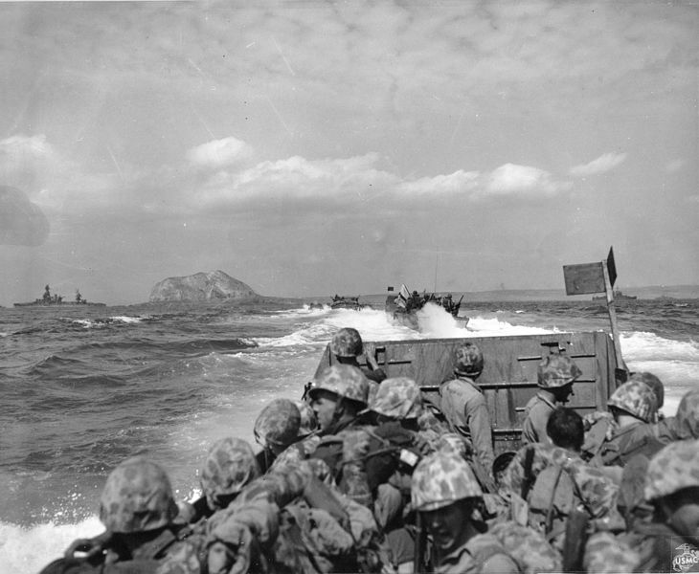
US naval vessels approach Iwo Jima for invasion.
The Allies were wrong.
The Japanese changed their tactics. They fought from:
dugouts
caves
tunnels
The Japanese hid until the Allies made their way inland.
Then they launched surprise attacks.
Notes:
**Click the video. It is a link to Kahn Academy at https://www.khanacademy.org/humanities/world-history/euro-hist/wo/v/1945-end-of-world-war-ii
This video talks about the Battle of Iwo Jima. Begin at the 3:05 mark until the 5:10 mark.

Slide 18
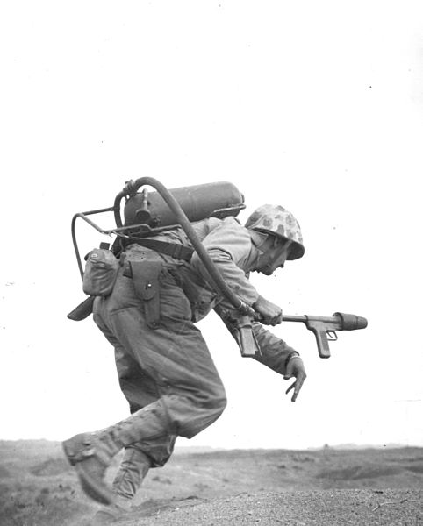
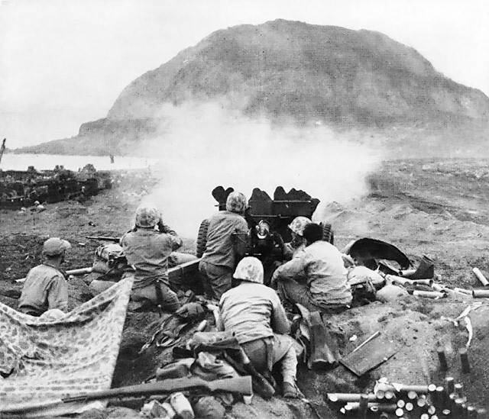
Allied troops used flamethrowers to flush out the Japanese from their hiding spots.
Allied troops used heavy artillery to fire on Japanese hiding spots.
Notes:
**Click on the map. It is a link to HBO at http://www.hbo.com/html/series/the-pacific/battlemaps/
Part 8 is about the Battle of Iwo JIma.
**Click on the map. It is a link to an animated map at http://www.pacificwaranimated.com/Iwo.html
This begins the same as the animated map for the Battle of the Philippine Sea & Battle of Leyte Gulf, but it changes to focus on the Battle of Iwo Jima.

Slide 19
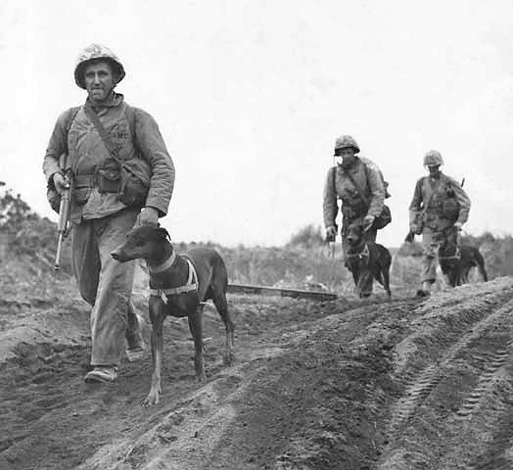
Allies WIN
K-9s were used in the front lines to find Japanese snipers and carry messages quickly.
Both sides suffered huge losses.
The Allies suffered 23,000 casualties.
The Japanese had 21,000 casualties out of the 22,000 who fought.
The US now had a close base for their B-29 bombers to attack Japan.

Slide 20
April 1, 1945 – June 22, 1945
One of the bloodiest battles of WWII
Okinawa could serve as a base for the air raids on Japan.
Japan
Once again Japanese troops used caves, tunnels, and dugouts.
Okinawa is a small island 350 miles southwest of Japan
An Allied plane fire bombs an area to kill Japanese troops that are hiding.
K-9s were used again to find hiding Japanese.
Notes:
**Click on the map. It is a link to HBO at http://www.hbo.com/html/series/the-pacific/battlemaps/
Part 9 is about the Battle of Okinawa.
**Click the video. It is a link to Kahn Academy at https://www.khanacademy.org/humanities/world-history/euro-hist/wo/v/1945-end-of-world-war-ii
This video talks about the Battle of Okinawa. Begin at the 5:10 mark until the 5:56 mark.

Slide 21
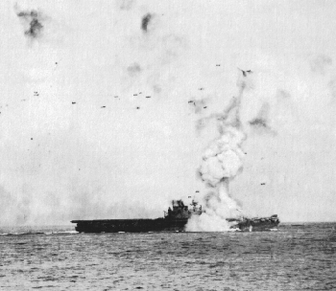
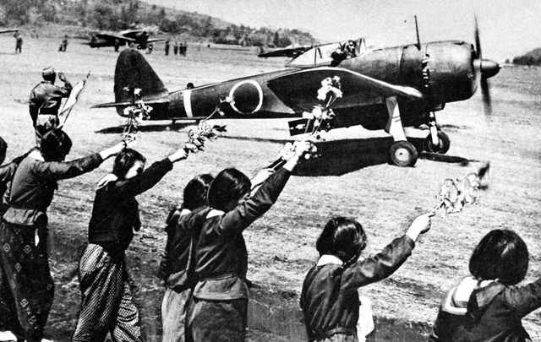
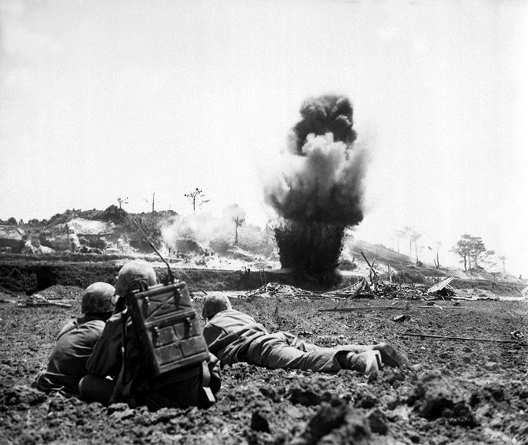
A kamikaze pilot is serenaded before takeoff.
USS Enterprise is hit by a kamikaze pilot.
A land target is hit by US battleships.
Allied troops bomb a cave using dynamite.
Notes:
**Click on the video. It is a link to History Channel at http://www.history.com/topics/world-war-ii/battle-of-leyte-gulf/videos/battle-okinawa?m=528e394da93ae&s=undefined&f=1&free=false
This short video is about the Battle of Okinawa.
**Click on the map. It is a link to an animated map at http://www.pacificwaranimated.com/Okinawa.html
This begins the same as the animated map for the Battle of the Philippine Sea/Battle of Leyte Gulf/Battle of Iwo Jima, but it changes to focus on the Battle of Okinawa.

Slide 22
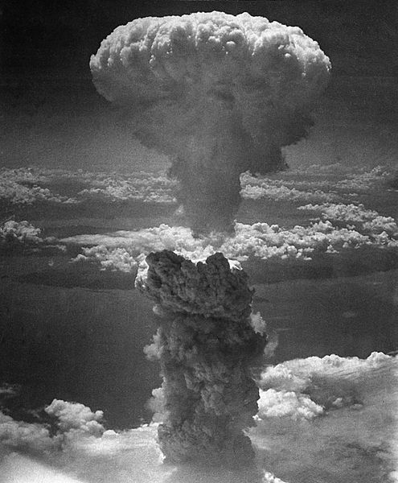
Japanese casualties = 70,000
WWII was over
Allied casualties = 40,000
Civilian casualties = 100,000
The bloodbath at Okinawa was a major factor in US President Harry Truman’s decision to NOT invade Japan.
President Truman decided to not risk tens, if not hundreds, of thousands American lives by invading.
The Axis Powers were defeated
Instead of invading Japan, President Truman decided to drop atomic bombs on Hiroshima (Aug. 6) and Nagasaki (Aug. 9), cities in Japan.
His plan worked. On Aug. 14, Japan surrendered.
Notes:
**Click the video. It is a link to Kahn Academy at https://www.khanacademy.org/humanities/world-history/euro-hist/wo/v/1945-end-of-world-war-ii
This video talks about the end of WWII. Begin at the 3:05 mark until the 5:56 mark until the end.

